Slide 1

Java™ How to Program, 9/e
© Copyright 1992-2012 by Pearson Education, Inc. All Rights Reserved.

Slide 3
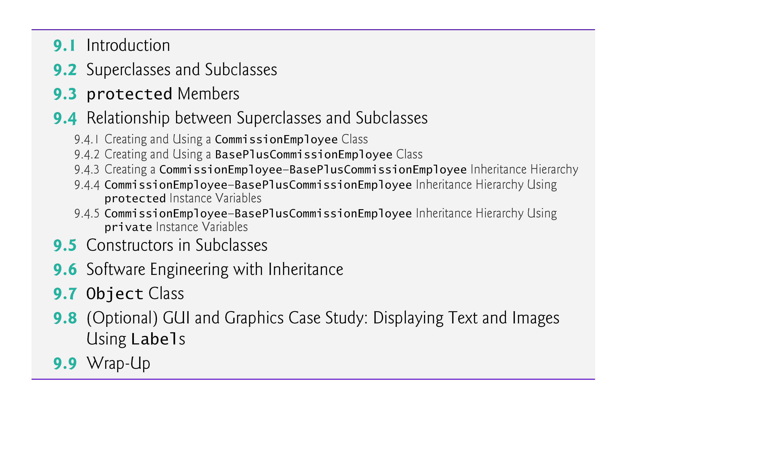
© Copyright 1992-2012 by Pearson Education, Inc. All Rights Reserved.

Slide 4

Inheritance
  A form of software reuse in which a new class is created by absorbing an existing class’s members and embellishing them with new or modified capabilities.
Benefits
  Can save time during program development by basing new classes on existing proven and debugged high-quality software.
  Increases the likelihood that a system will be implemented and maintained effectively.
© Copyright 1992-2012 by Pearson Education, Inc. All Rights Reserved.

Slide 5

When creating a class, rather than declaring completely new members, you can designate that the new class should inherit the members of an existing class.
  Existing class is the superclass
  New class is the subclass
Each subclass can be a superclass of future subclasses.
A subclass can add its own fields and methods.
A subclass is more specific than its superclass and represents a more specialized group of objects.
The subclass exhibits the behaviors of its superclass and can add behaviors that are specific to the subclass.
  This is why inheritance is sometimes referred to as specialization.
© Copyright 1992-2012 by Pearson Education, Inc. All Rights Reserved.

Slide 6

Vehicles
Vehicle (Superclass)
  Attributes: make, model, year, weight
  Methods: start(), stop(), accelerate()
  LandVehicle (Subclass of Vehicle)
    Specific Attributes: number_of_wheels, fuel_type
    Specific Methods: honk()
    Car (Subclass of LandVehicle)
      Specific Attributes: trunk_size, sedan_or_suv
      Specific Methods: open_trunk(), adjust_mirror()
    Bicycle (Subclass of LandVehicle)
      Specific Attributes: has_gears, gear_count
      Specific Methods: pedal(), ring_bell()

Slide 7
Shapes
Shape (Superclass)
  Attributes: color, material
  Methods: calculate_area(), calculate_perimeter()
  TwoDimensionalShape (Subclass of Shape)
    Specific Attributes: plane_surface
    Specific Methods: draw()
    Circle (Subclass of TwoDimensionalShape)
      Specific Attributes: radius
      Specific Methods: calculate_diameter()
    Rectangle (Subclass of TwoDimensionalShape)
      Specific Attributes: length, width
      Specific Methods: is_square()

Slide 8
The direct superclass is the superclass from which the subclass explicitly inherits.
An indirect superclass is any class above the direct superclass in the class hierarchy.
The Java class hierarchy begins with class Object (in package java.lang)
  Every class in Java directly or indirectly extends (or “inherits from”) Object.
Java supports only single inheritance, in which each class is derived from exactly one direct superclass.
© Copyright 1992-2012 by Pearson Education, Inc. All Rights Reserved.

Slide 9
We distinguish between the is-a relationship and the has-a relationship
Is-a represents inheritance
  In an is-a relationship, an object of a subclass can also be treated as an object of its superclass
Has-a represents composition
  In a has-a relationship, an object contains as members references to other objects
© Copyright 1992-2012 by Pearson Education, Inc. All Rights Reserved.

Slide 10

Figure 9.1 lists several simple examples of superclasses and subclasses
  Superclasses tend to be “more general” and subclasses “more specific.”
  Because every subclass object is an object of its superclass, and one superclass can have many subclasses, the set of objects represented by a superclass is typically larger than the set of objects represented by any of its subclasses.
© Copyright 1992-2012 by Pearson Education, Inc. All Rights Reserved.

Slide 11
© Copyright 1992-2012 by Pearson Education, Inc. All Rights Reserved.

Slide 12

A superclass exists in a hierarchical relationship with its subclasses.
Fig. 9.2 shows a sample university community class hierarchy
  Also called an inheritance hierarchy.
Each arrow in the hierarchy represents an is-a relationship.
Follow the arrows upward in the class hierarchy
  an Employee is a CommunityMember”
  “a Teacher is a Faculty member.”
CommunityMember is the direct superclass of Employee, Student and Alumnus and is an indirect superclass of all the other classes in the diagram.
Starting from the bottom, you can follow the arrows and apply the is-a relationship up to the topmost superclass.
© Copyright 1992-2012 by Pearson Education, Inc. All Rights Reserved.

Slide 13
© Copyright 1992-2012 by Pearson Education, Inc. All Rights Reserved.

Slide 14
Fig. 9.3 shows a Shape inheritance hierarchy.
Van follow the arrows from the bottom of the diagram to the topmost superclass in this class hierarchy to identify several is-a relationships.
  A Triangle is a TwoDimensionalShape and is a Shape
  ASphere is a ThreeDimensionalShape and is a Shape.
© Copyright 1992-2012 by Pearson Education, Inc. All Rights Reserved.

Slide 15
© Copyright 1992-2012 by Pearson Education, Inc. All Rights Reserved.

Slide 16
Not every class relationship is an inheritance relationship.
Has-a relationship
  Create classes by composition of existing classes.
  Example: Given the classes Employee, BirthDate and TelephoneNumber, it’s improper to say that an Employee is a BirthDate or that an Employee is a TelephoneNumber.
  However, an Employee has a BirthDate, and an Employee has a TelephoneNumber.
© Copyright 1992-2012 by Pearson Education, Inc. All Rights Reserved.

Slide 17

Objects of all classes that extend a common superclass can be treated as objects of that superclass.
  Commonality expressed in the members of the superclass.
Inheritance issue
  A subclass can inherit methods that it does not need or should not have.
  Even when a superclass method is appropriate for a subclass, that subclass often needs a customized version of the method.
  The subclass can override (redefine) the superclass method with an appropriate implementation.
© Copyright 1992-2012 by Pearson Education, Inc. All Rights Reserved.

Slide 18

A class’s public members are accessible wherever the program has a reference to an object of that class or one of its subclasses.
A class’s private members are accessible only within the class itself.
protected access is an intermediate level of access between public and private.
  A superclass’s protected members can be accessed by members of that superclass, by members of its subclasses and by members of other classes in the same package
    protected members also have package access.
  All public and protected superclass members retain their original access modifier when they become members of the subclass.
© Copyright 1992-2012 by Pearson Education, Inc. All Rights Reserved.

Slide 19

A superclass’s private members are hidden in its subclasses
  They can be accessed only through the public or protected methods inherited from the superclass
Subclass methods can refer to public and protected members inherited from the superclass simply by using the member names.
When a subclass method overrides an inherited superclass method, the superclass method can be accessed from the subclass by preceding the superclass method name with keyword super and a dot (.) separator.
© Copyright 1992-2012 by Pearson Education, Inc. All Rights Reserved.

Slide 20
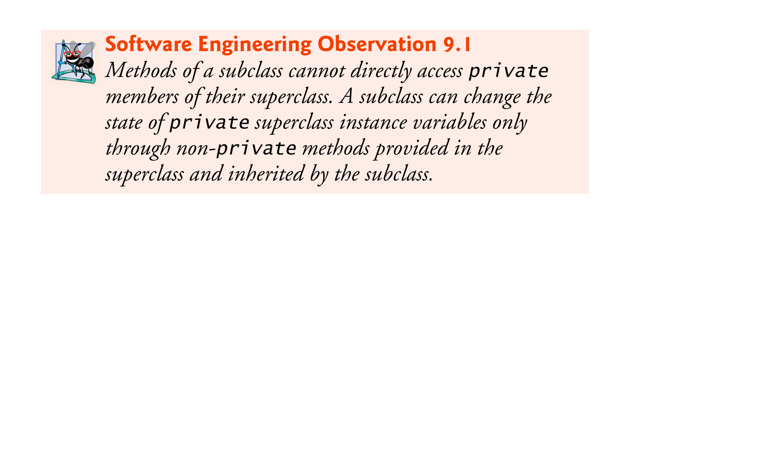
© Copyright 1992-2012 by Pearson Education, Inc. All Rights Reserved.

Slide 21
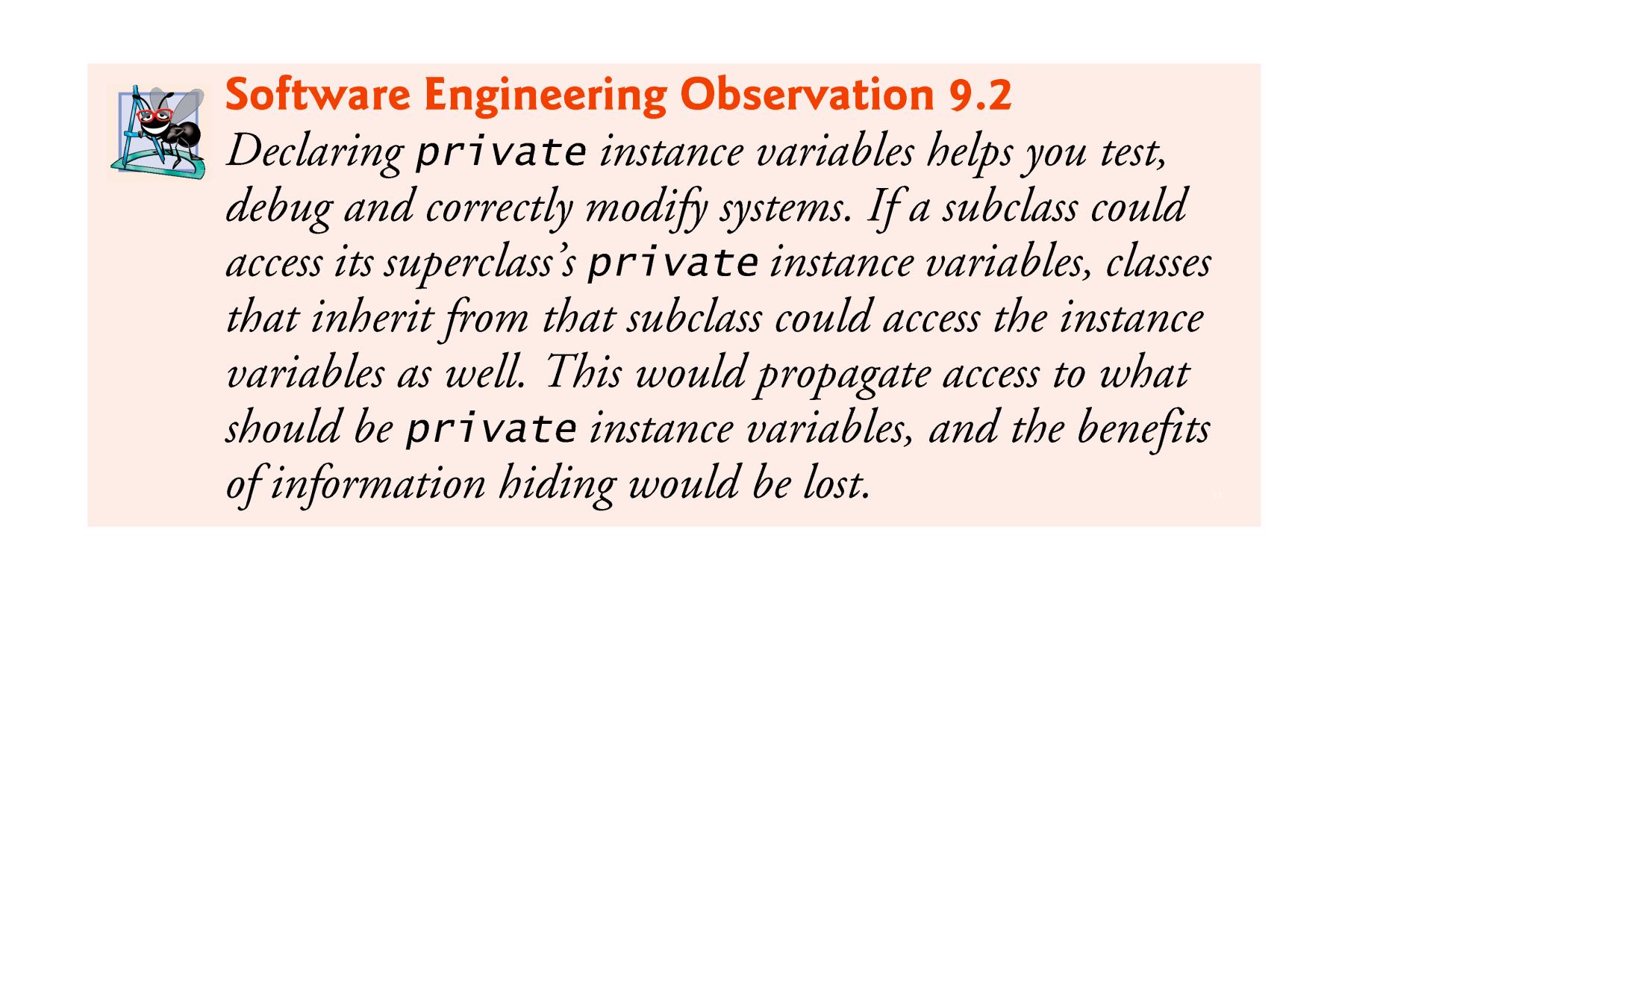
© Copyright 1992-2012 by Pearson Education, Inc. All Rights Reserved.

Slide 22

Inheritance hierarchy containing types of employees in a company’s payroll application
Commission employees are paid a percentage of their sales
Base-salaried commission employees receive a base salary plus a percentage of their sales.
© Copyright 1992-2012 by Pearson Education, Inc. All Rights Reserved.

Slide 23

Class CommissionEmployee (Fig. 9.4) extends class Object (from package java.lang).
  CommissionEmployee inherits Object’s methods.
  If you don’t explicitly specify which class a new class extends, the class extends Object implicitly.
© Copyright 1992-2012 by Pearson Education, Inc. All Rights Reserved.

Slide 27
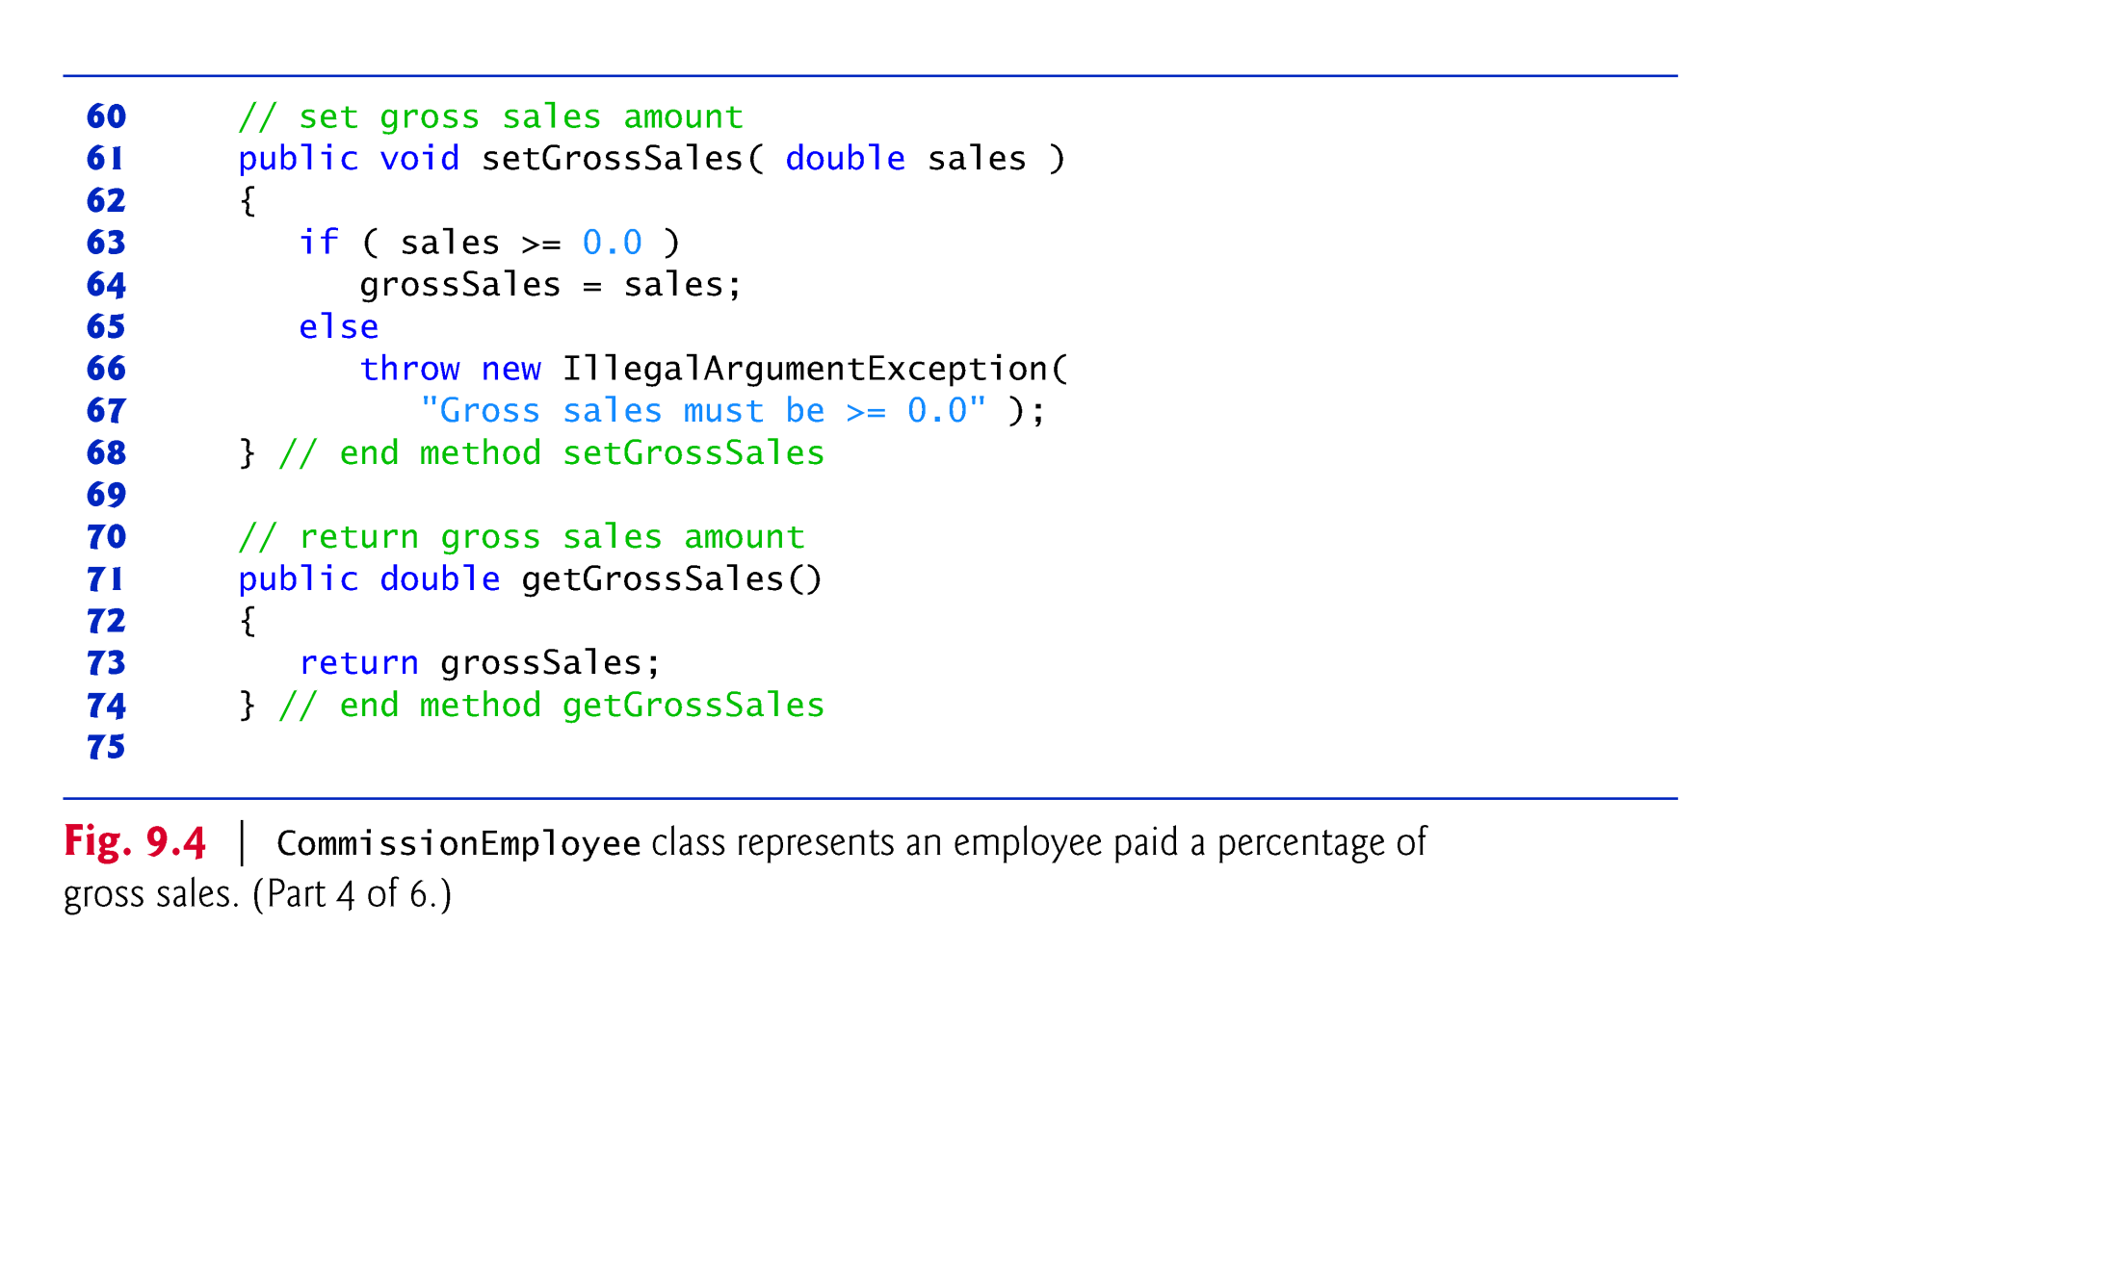

Slide 28
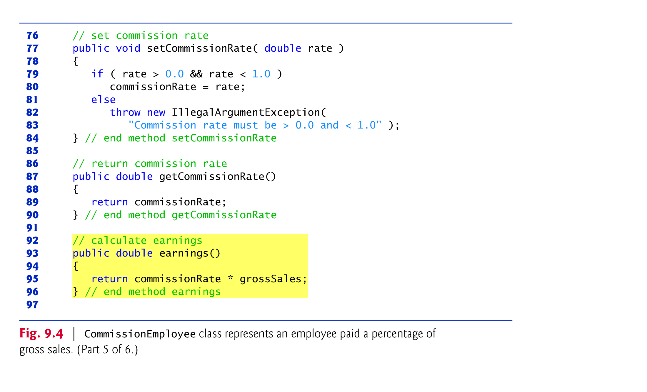

Slide 29
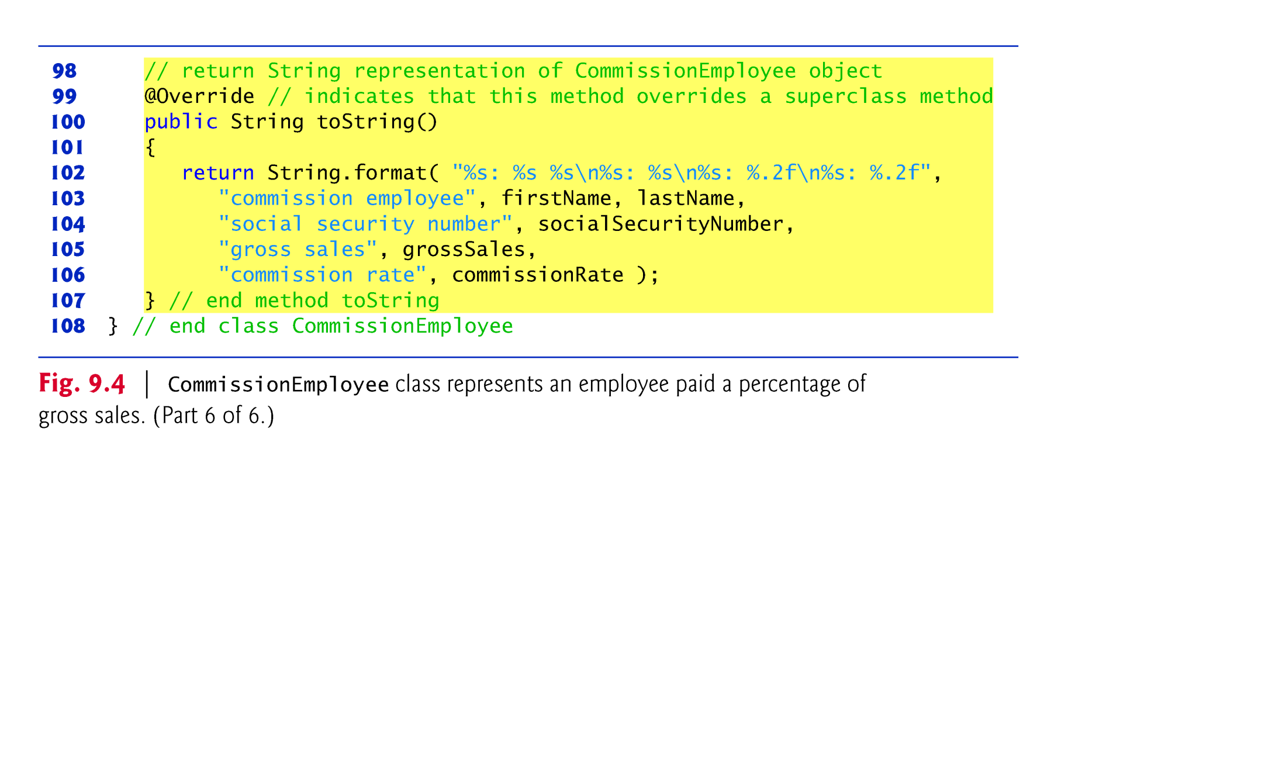

Slide 30

Constructors are not inherited.
The first task of a subclass constructor is to call its direct superclass’s constructor explicitly or implicitly
  Ensures that the instance variables inherited from the superclass are initialized properly.
If the code does not include an explicit call to the superclass constructor, Java implicitly calls the superclass’s default or no-argument constructor.
A class’s default constructor calls the superclass’s default or no-argument constructor.
© Copyright 1992-2012 by Pearson Education, Inc. All Rights Reserved.

Slide 31
toString is one of the methods that every class inherits directly or indirectly from class Object.
  Returns a String representing an object.
  Called implicitly whenever an object must be converted to a String representation.
Class Object’s toString method returns a String that includes the name of the object’s class.
  This is primarily a placeholder that can be overridden by a subclass to specify an appropriate String representation.
© Copyright 1992-2012 by Pearson Education, Inc. All Rights Reserved.

Slide 32
To override a superclass method, a subclass must declare a method with the same signature as the superclass method
@Override annotation
  Indicates that a method should override a superclass method with the same signature.
  If it does not, a compilation error occurs.
© Copyright 1992-2012 by Pearson Education, Inc. All Rights Reserved.

Slide 33
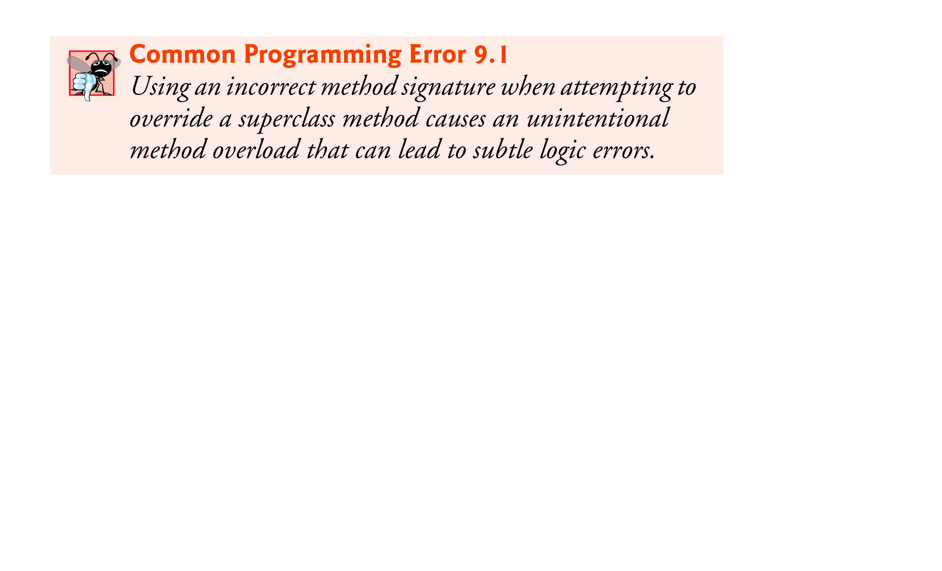
© Copyright 1992-2012 by Pearson Education, Inc. All Rights Reserved.

Slide 34
© Copyright 1992-2012 by Pearson Education, Inc. All Rights Reserved.

Slide 35
© Copyright 1992-2012 by Pearson Education, Inc. All Rights Reserved.

Slide 36
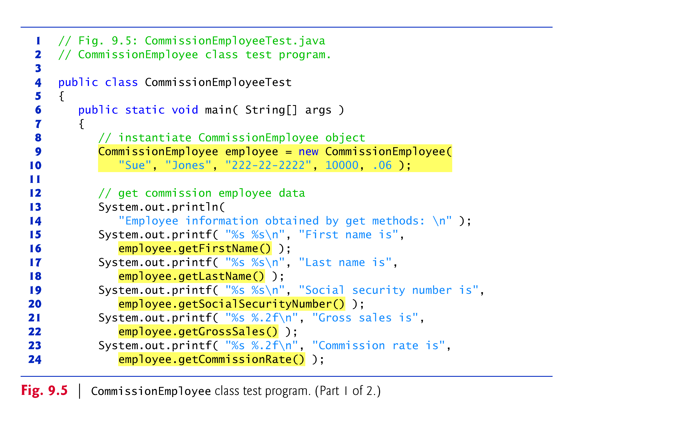
© Copyright 1992-2012 by Pearson Education, Inc. All Rights Reserved.

Slide 37
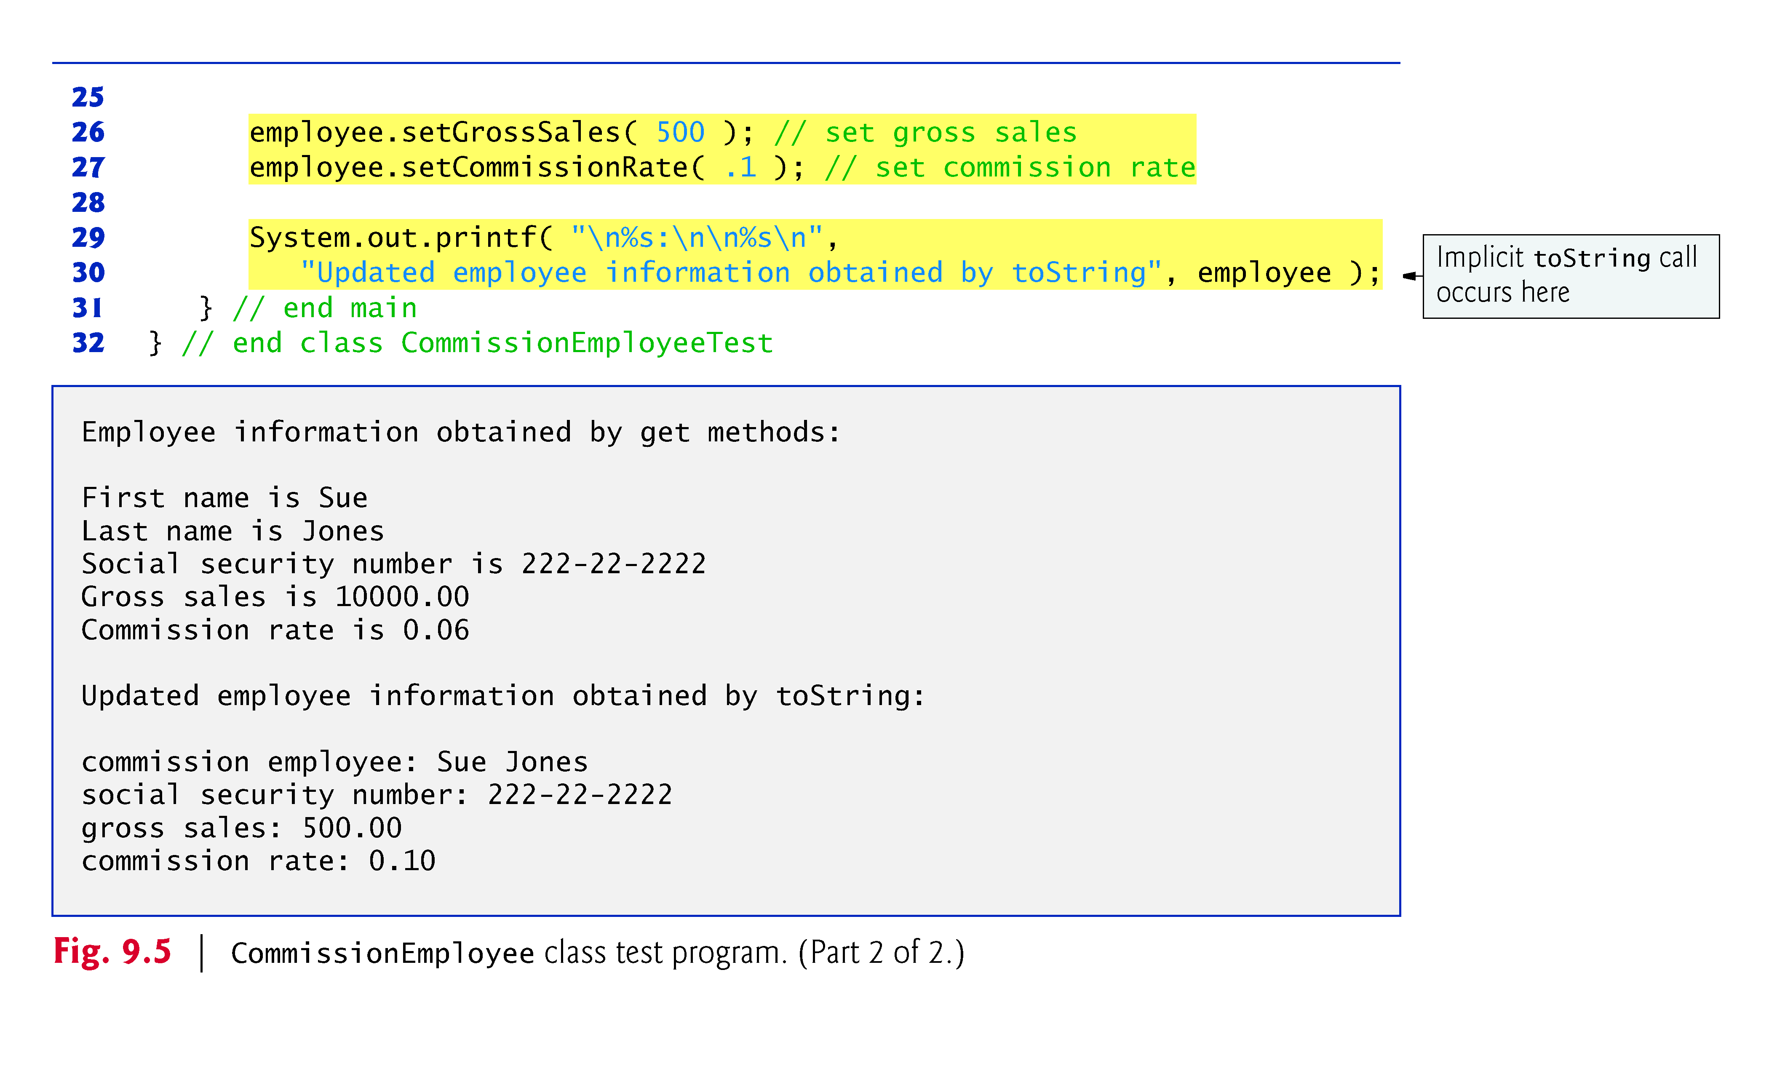
© Copyright 1992-2012 by Pearson Education, Inc. All Rights Reserved.

Slide 38

Class BasePlusCommissionEmployee (Fig. 9.6) contains a first name, last name, social security number, gross sales amount, commission rate and base salary.
  All but the base salary are in common with class CommissionEmployee.
Class BasePlusCommissionEmployee’s public services include a constructor, and methods earnings, toString and get and set for each instance variable
  Most of these are in common with class CommissionEmployee.
© Copyright 1992-2012 by Pearson Education, Inc. All Rights Reserved.

Slide 40
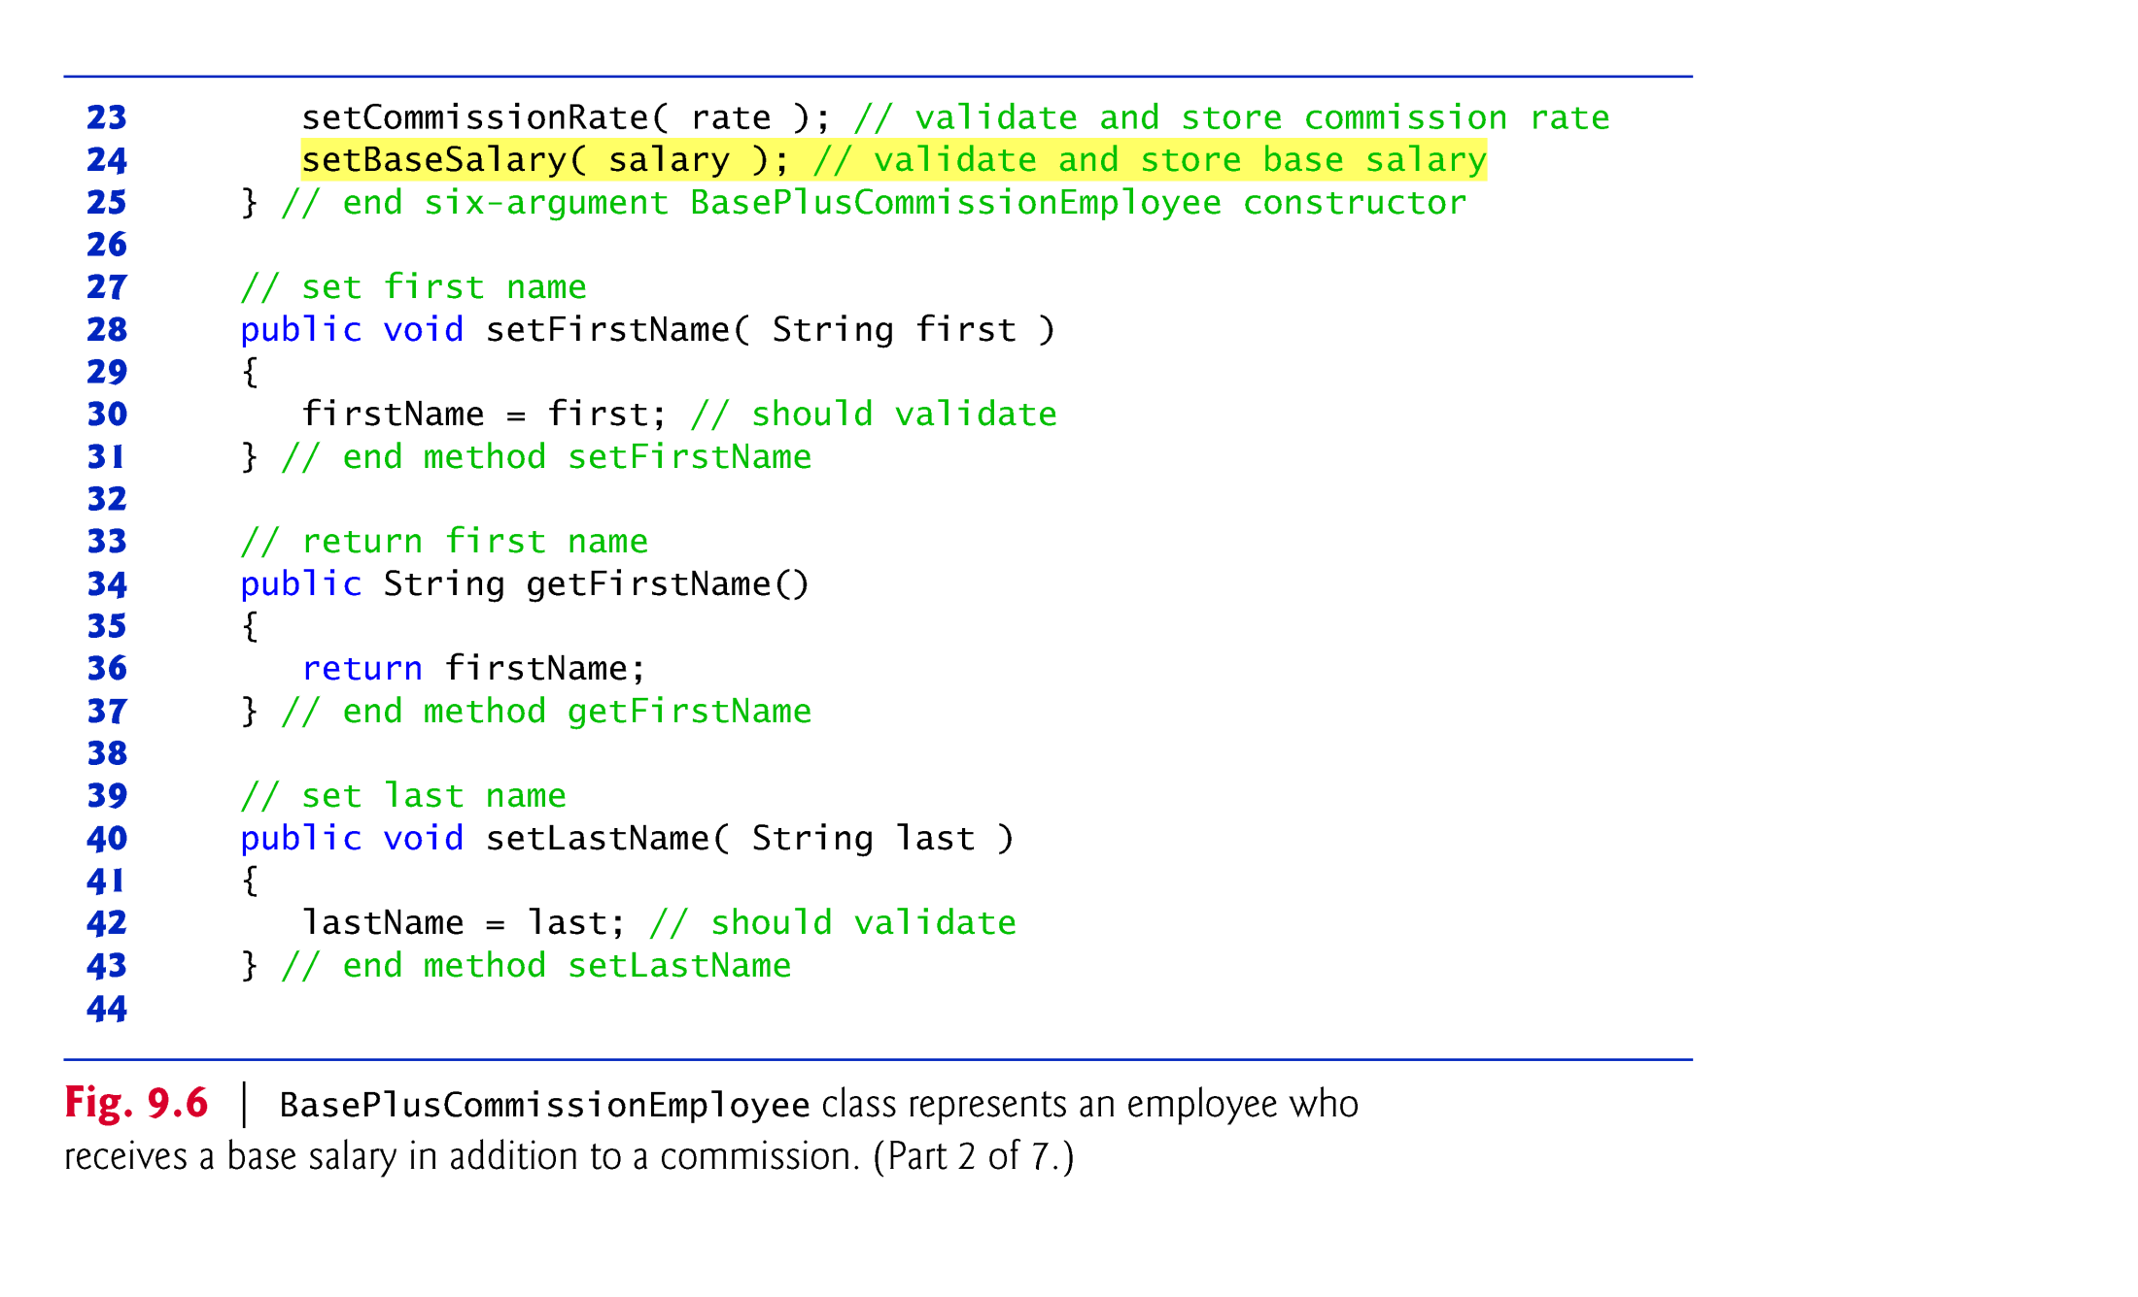

Slide 41
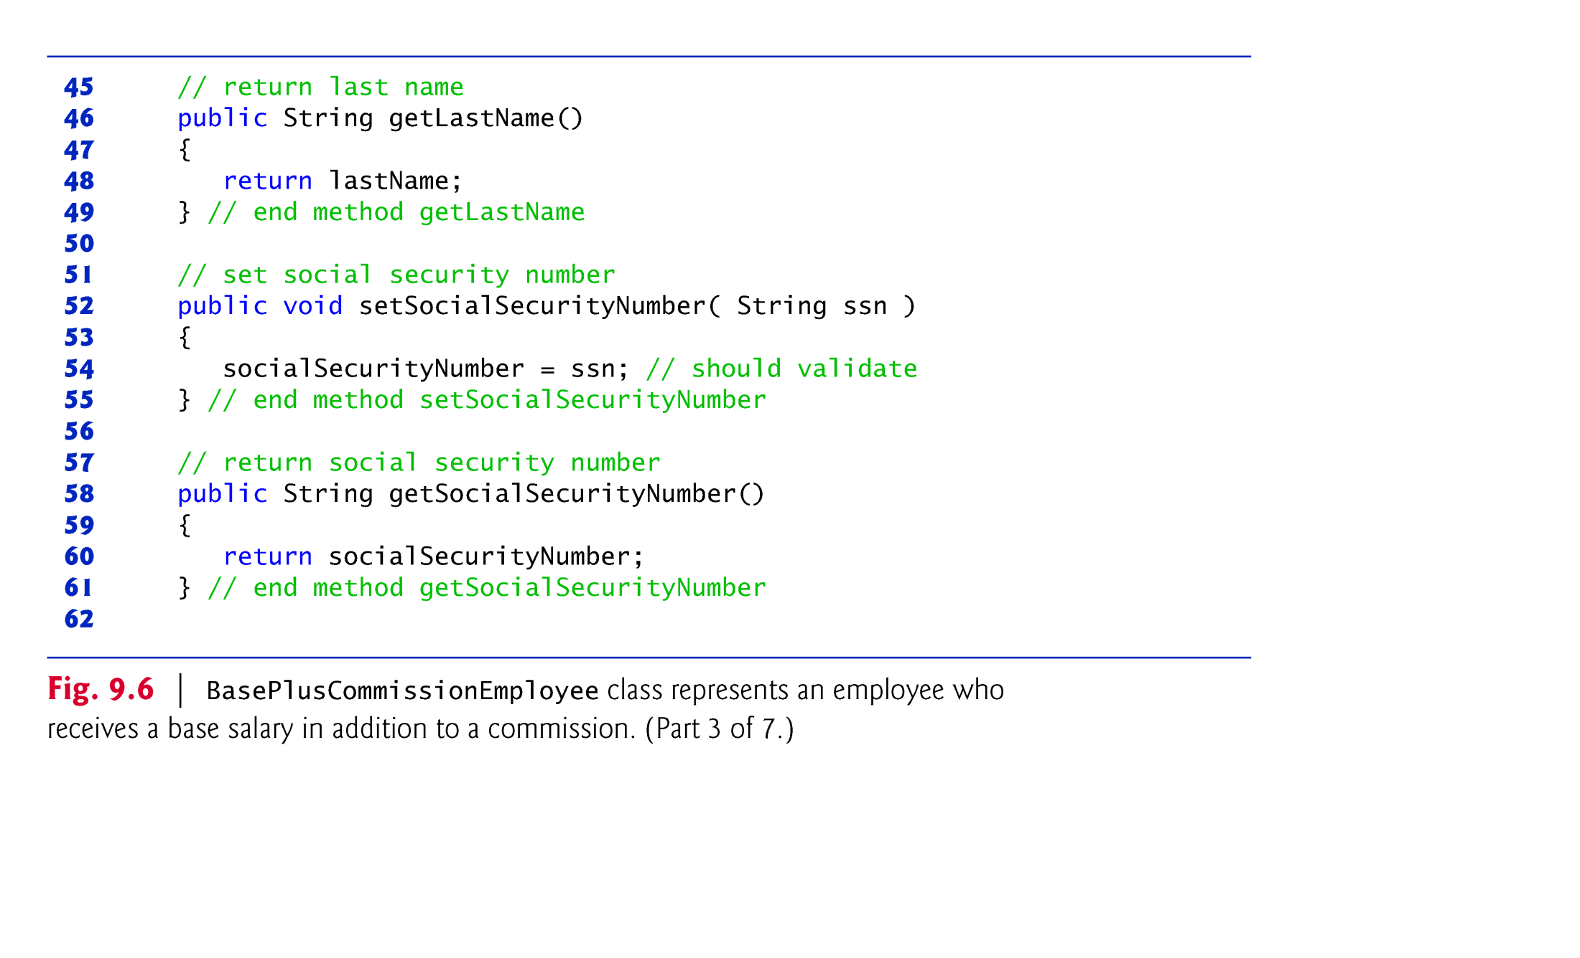

Slide 42
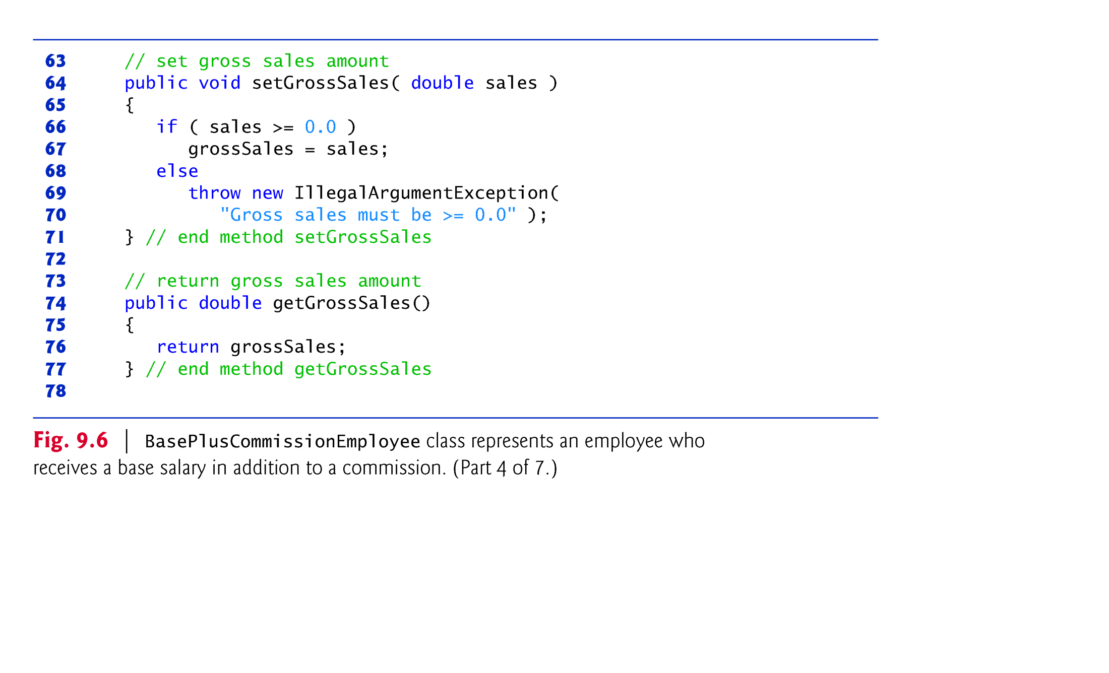

Slide 43
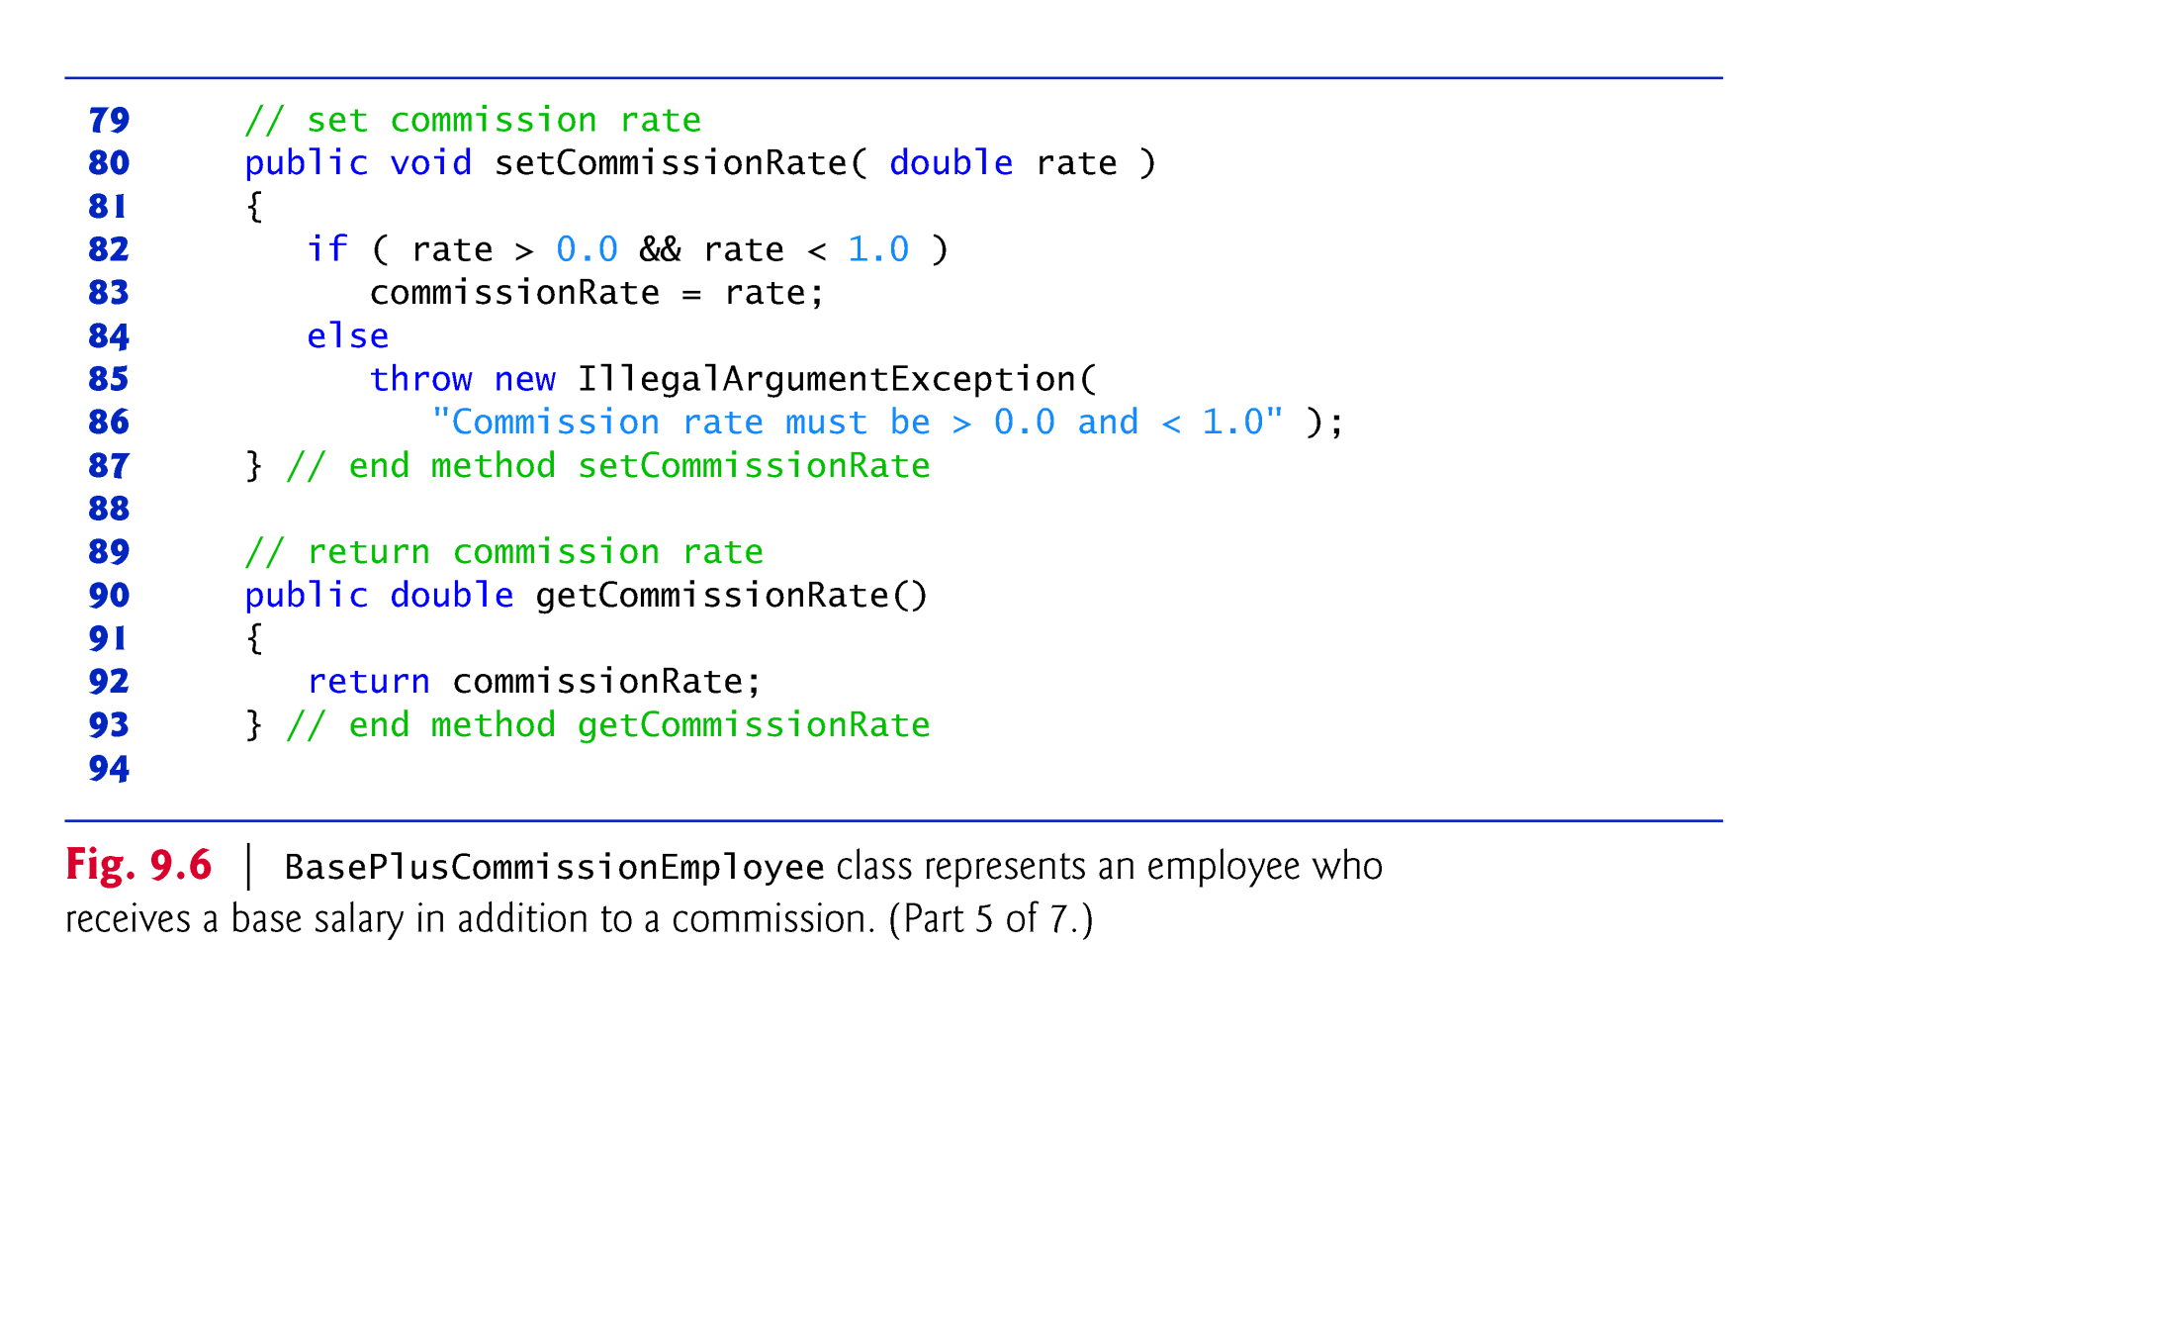

Slide 44
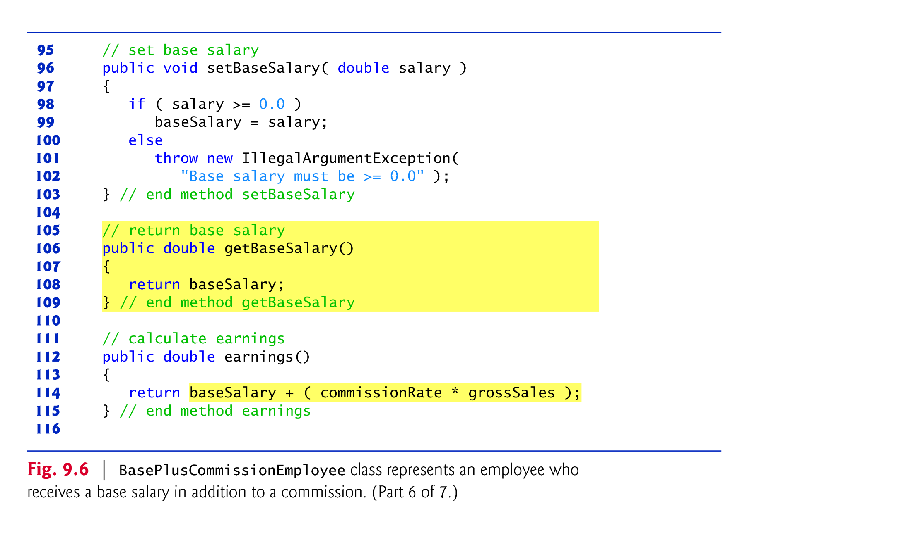

Slide 45
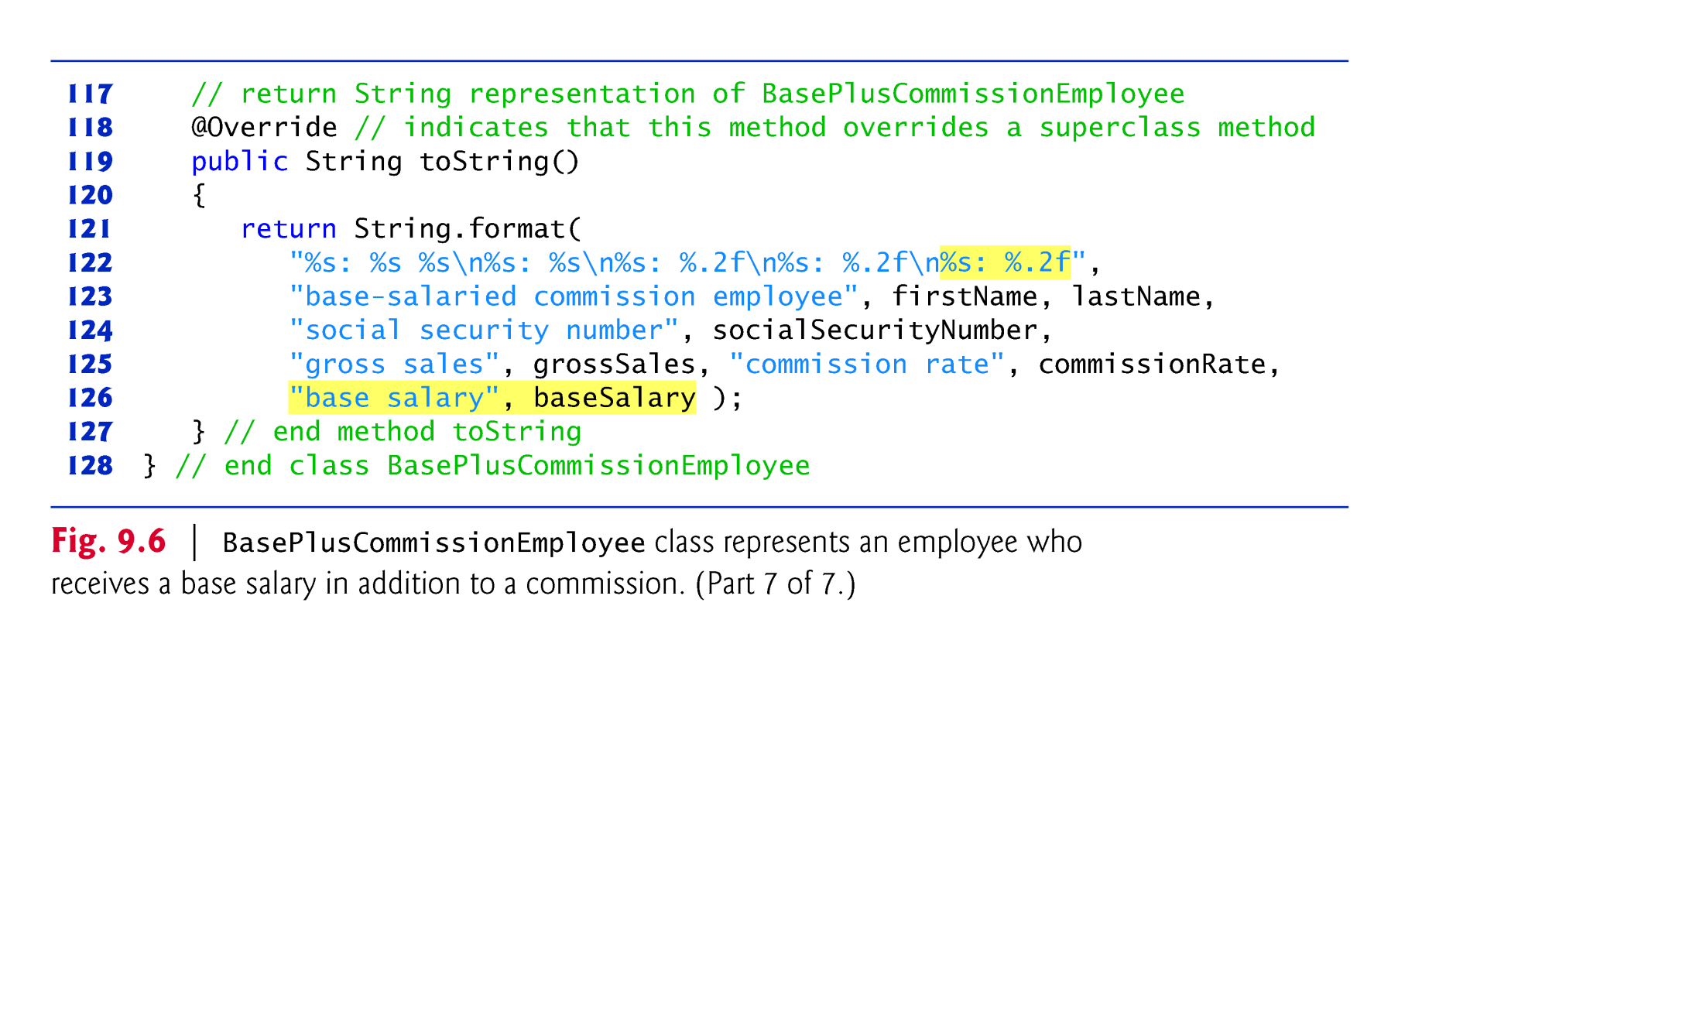

Slide 46

Class BasePlusCommissionEmployee does not specify “extends Object”
  Implicitly extends Object.
BasePlusCommissionEmployee’s constructor invokes class Object’s default constructor implicitly.
© Copyright 1992-2012 by Pearson Education, Inc. All Rights Reserved.

Slide 47
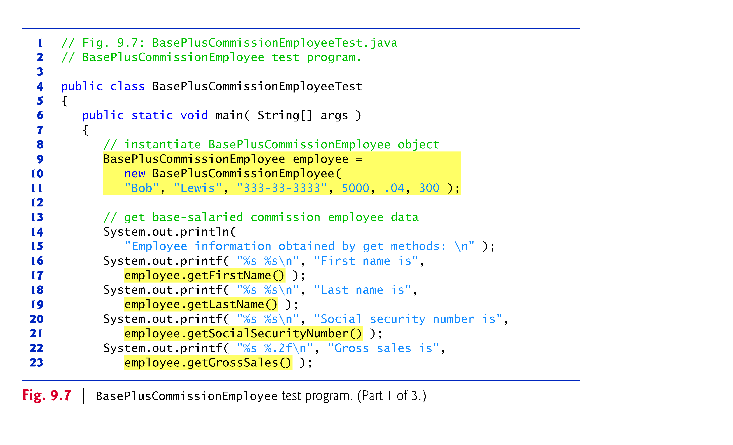
© Copyright 1992-2012 by Pearson Education, Inc. All Rights Reserved.

Slide 48
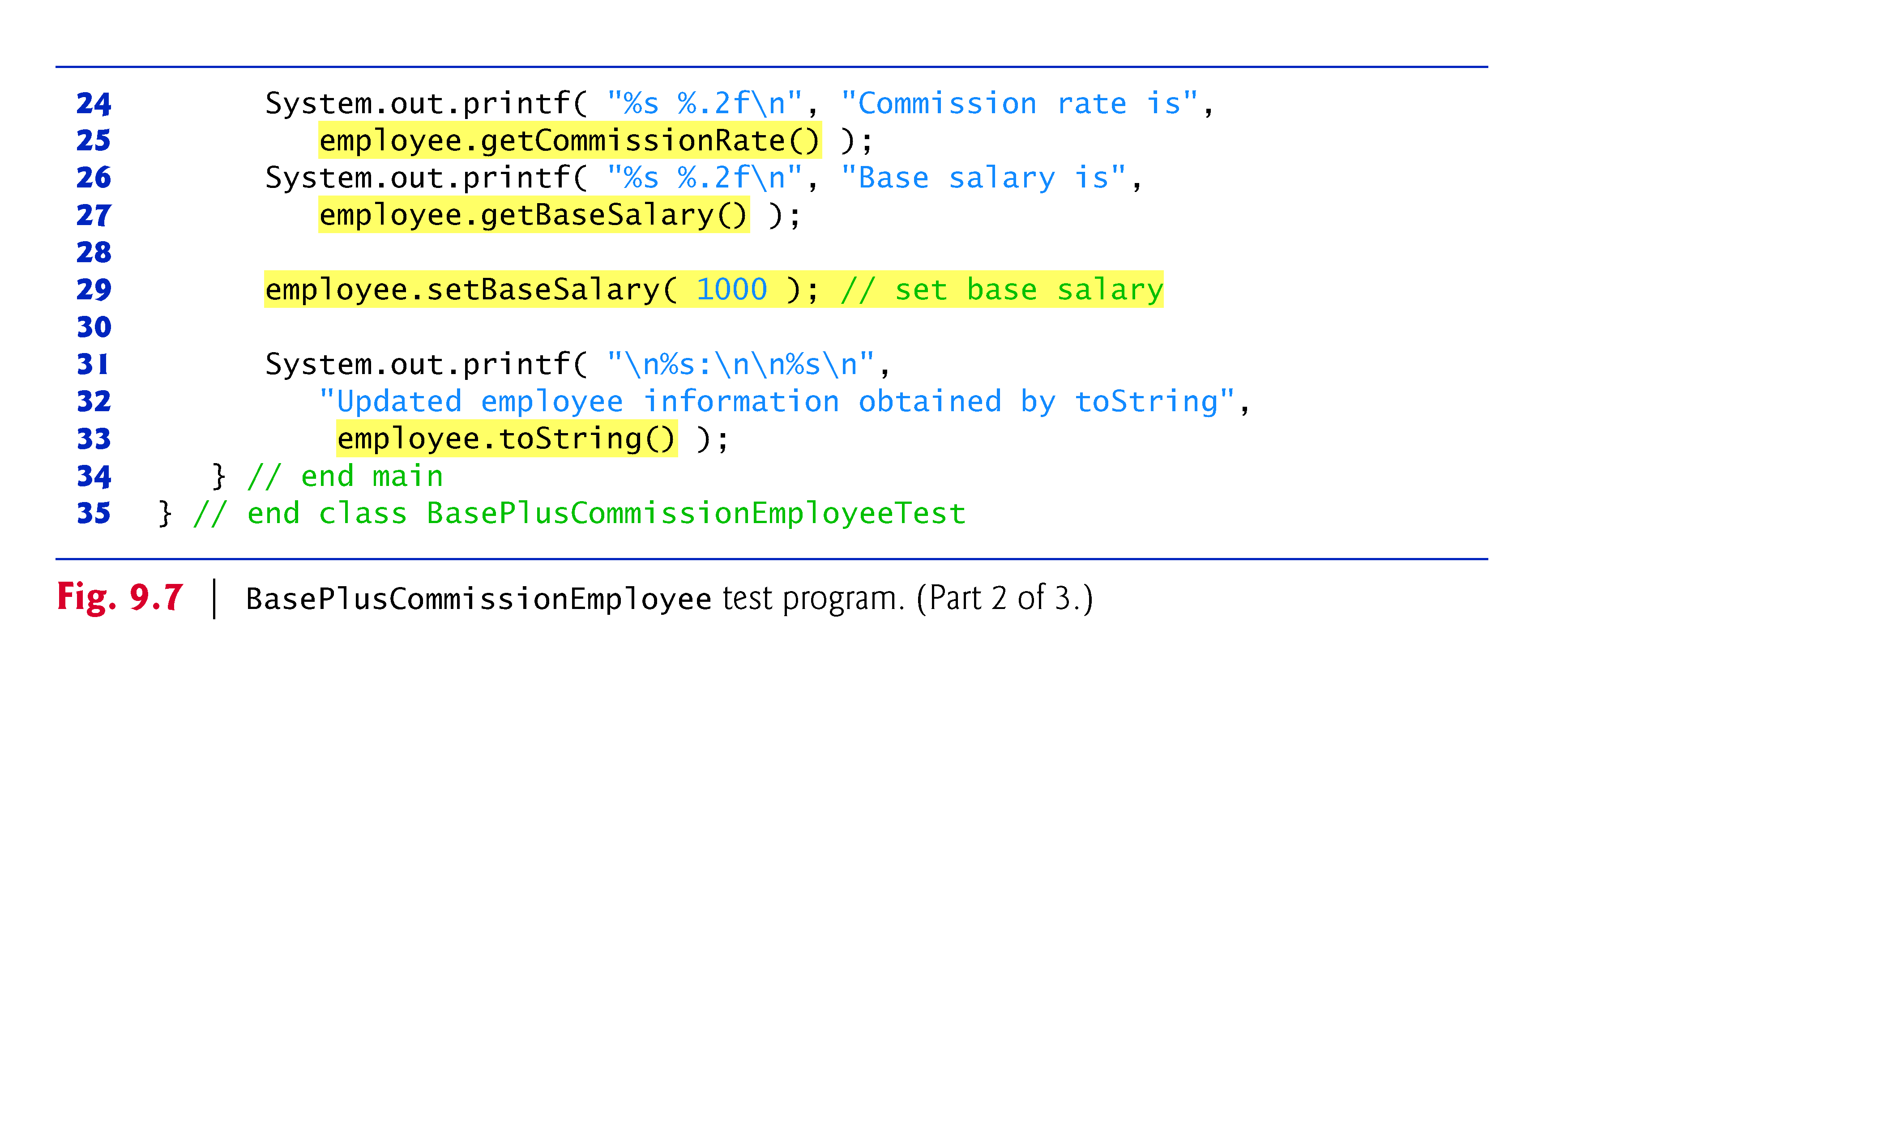
© Copyright 1992-2012 by Pearson Education, Inc. All Rights Reserved.

Slide 49
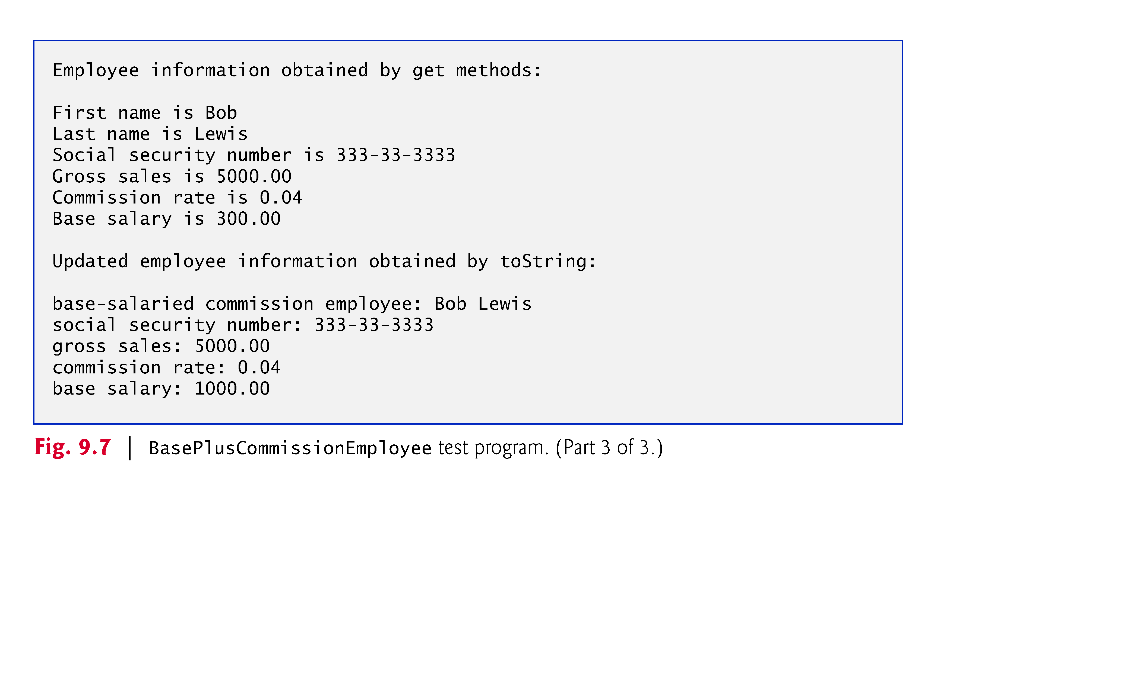
© Copyright 1992-2012 by Pearson Education, Inc. All Rights Reserved.

Slide 50
Much of BasePlusCommissionEmployee’s code is similar, or identical, to that of CommissionEmployee.
private instance variables firstName and lastName and methods setFirstName, getFirstName, setLastName and getLastName are identical.
  Both classes also contain corresponding get and set methods.
The constructors are almost identical
  BasePlusCommissionEmployee’s constructor also sets the base-Salary.
The toString methods are nearly identical
  BasePlusCommissionEmployee’s toString also outputs instance variable baseSalary
© Copyright 1992-2012 by Pearson Education, Inc. All Rights Reserved.

Slide 51
We literally copied CommissionEmployee’s code, pasted it into BasePlusCommissionEmployee, then modified the new class to include a base salary and methods that manipulate the base salary.
  This “copy-and-paste” approach is often error prone and time consuming.
  It spreads copies of the same code throughout a system, creating a code-maintenance nightmare.
© Copyright 1992-2012 by Pearson Education, Inc. All Rights Reserved.

Slide 52

© Copyright 1992-2012 by Pearson Education, Inc. All Rights Reserved.

Slide 53
Class BasePlusCommissionEmployee class extends class CommissionEmployee
A BasePlusCommissionEmployee object is a CommissionEmployee
  Inheritance passes on class CommissionEmployee’s capabilities.
Class BasePlusCommissionEmployee also has instance variable baseSalary.
Subclass BasePlusCommissionEmployee inherits CommissionEmployee’s instance variables and methods
  Only the superclass’s public and protected members are directly accessible in the subclass.
© Copyright 1992-2012 by Pearson Education, Inc. All Rights Reserved.

Slide 54
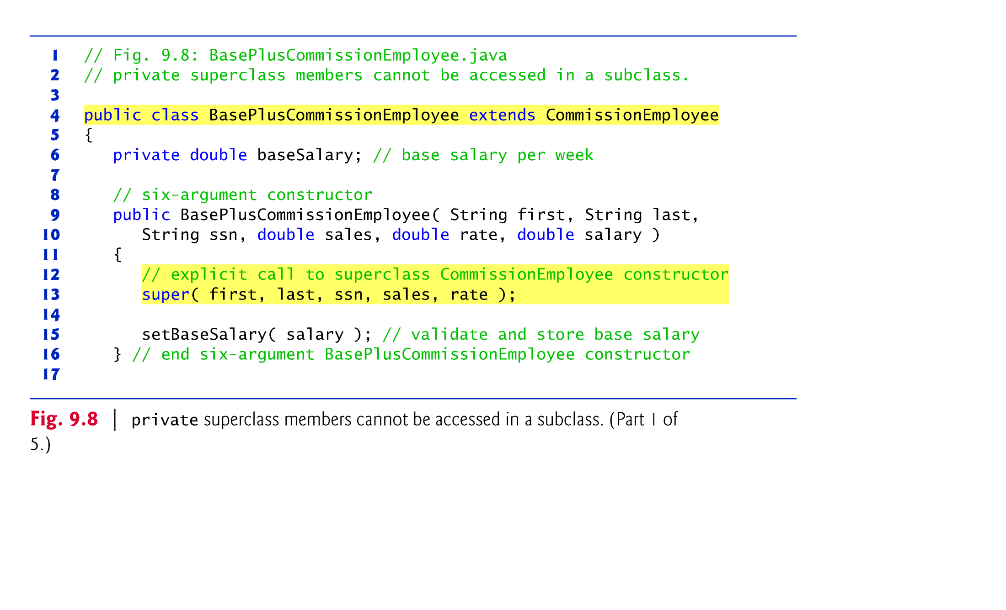

Slide 55
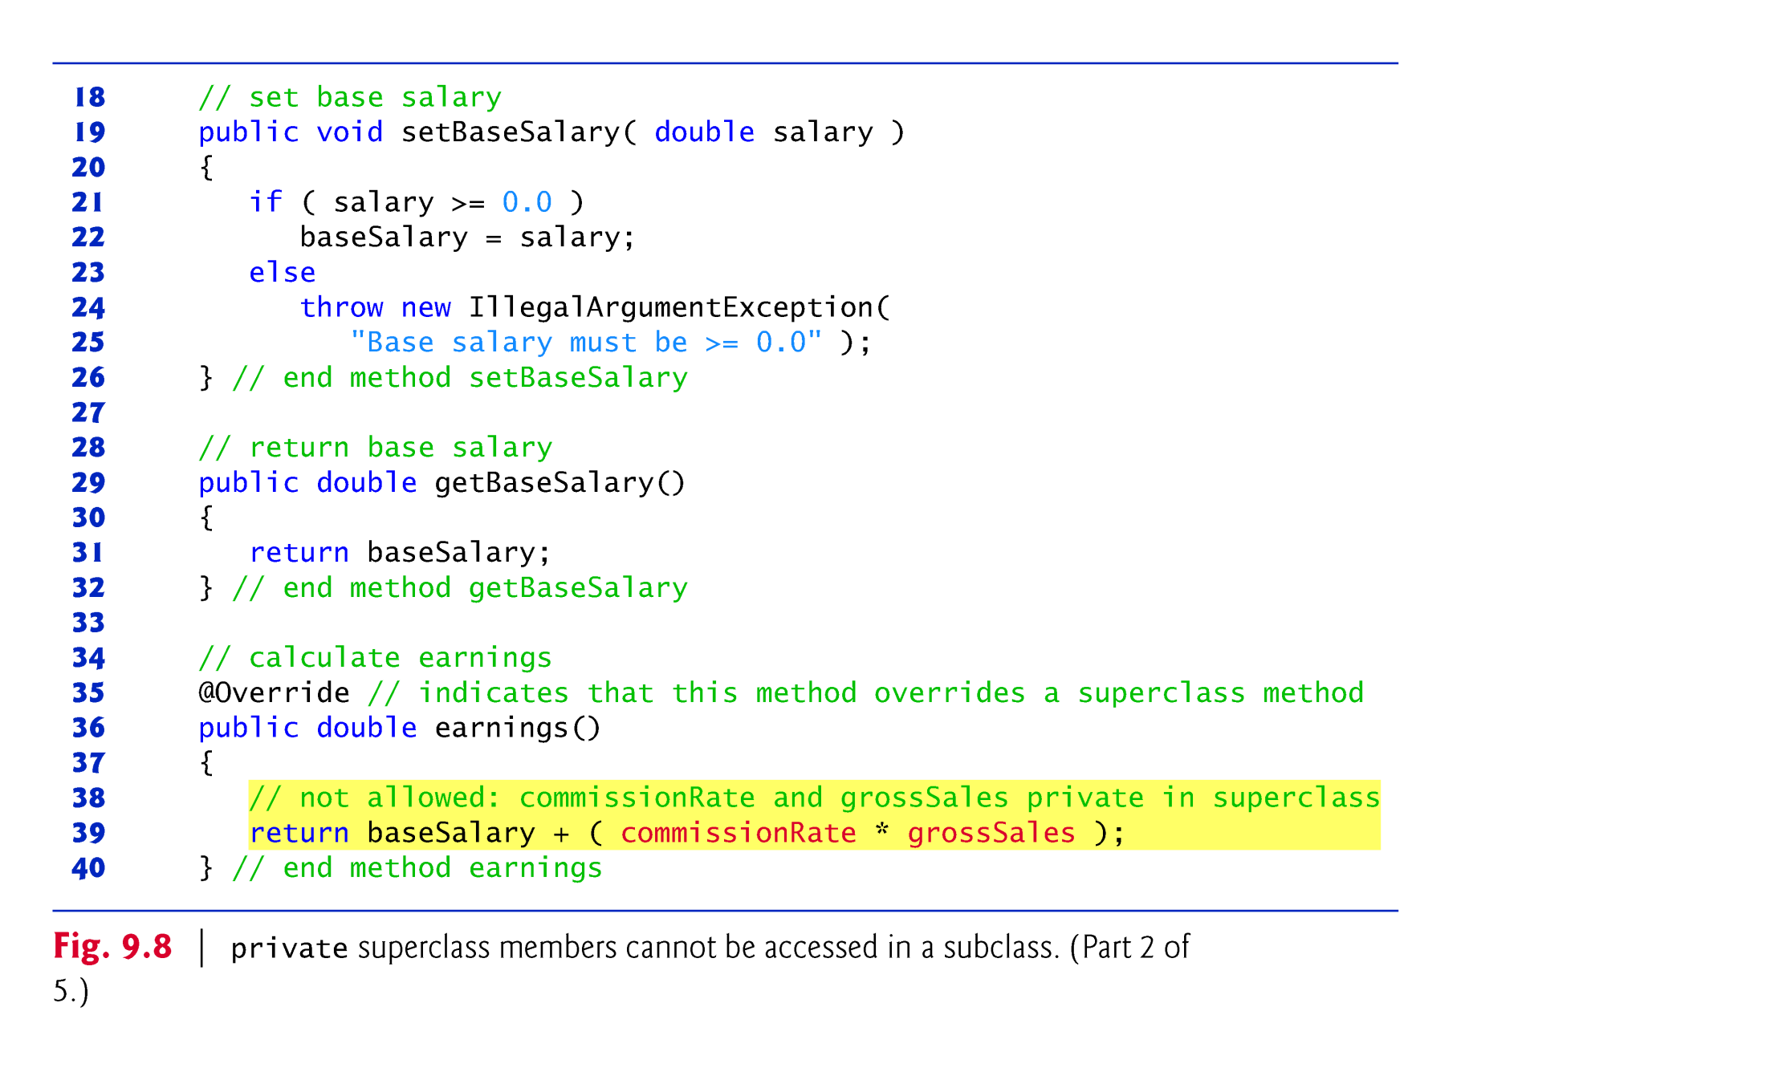

Slide 56
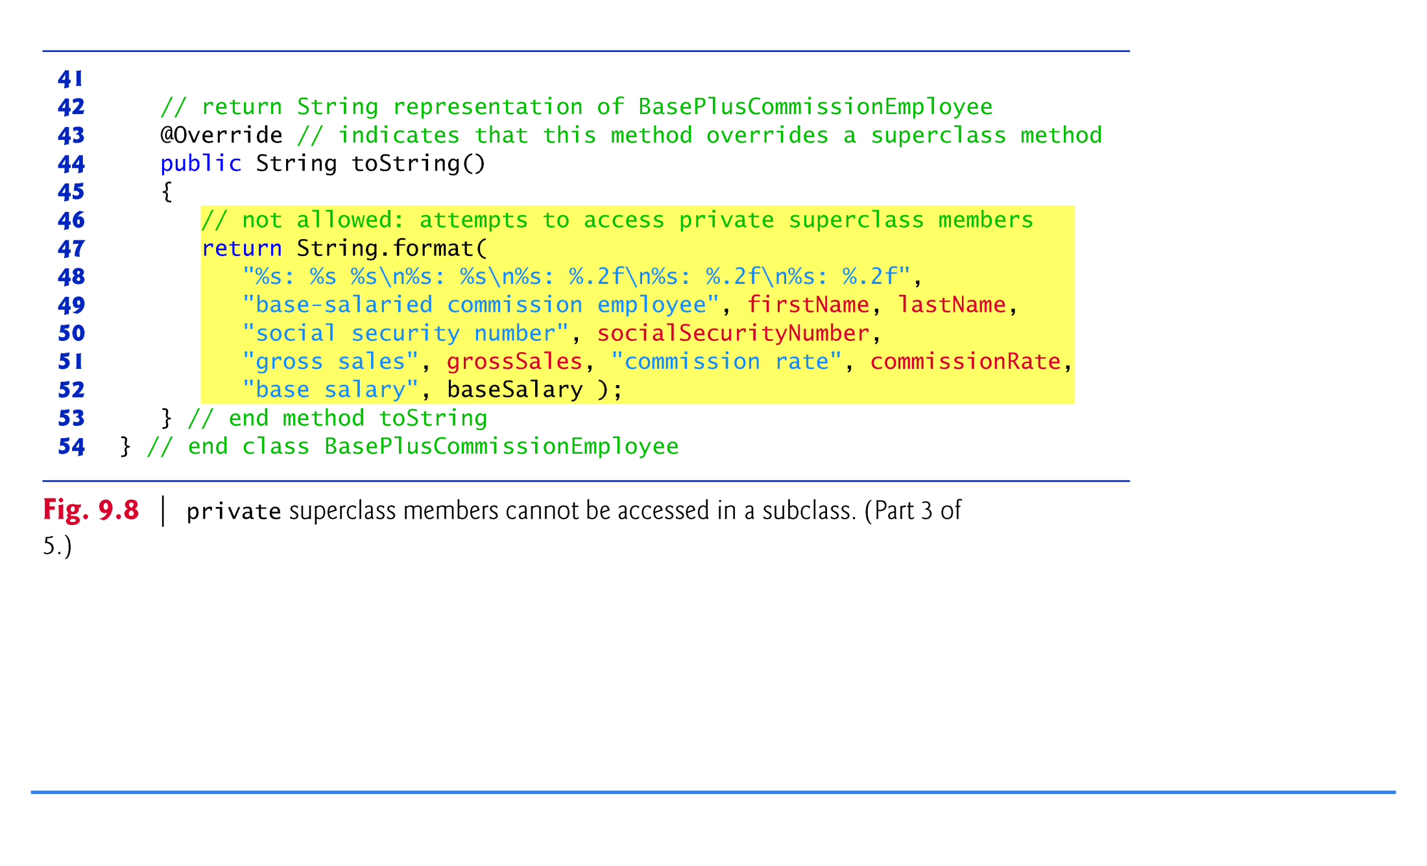

Slide 57
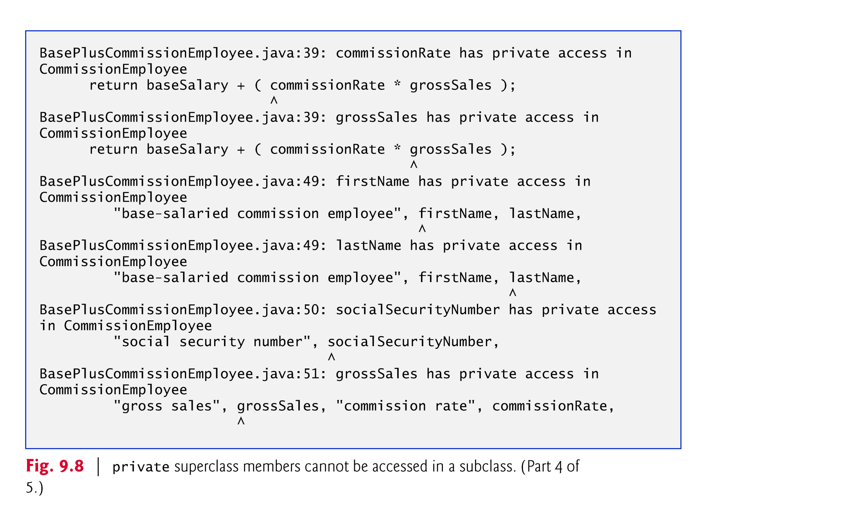

Slide 58
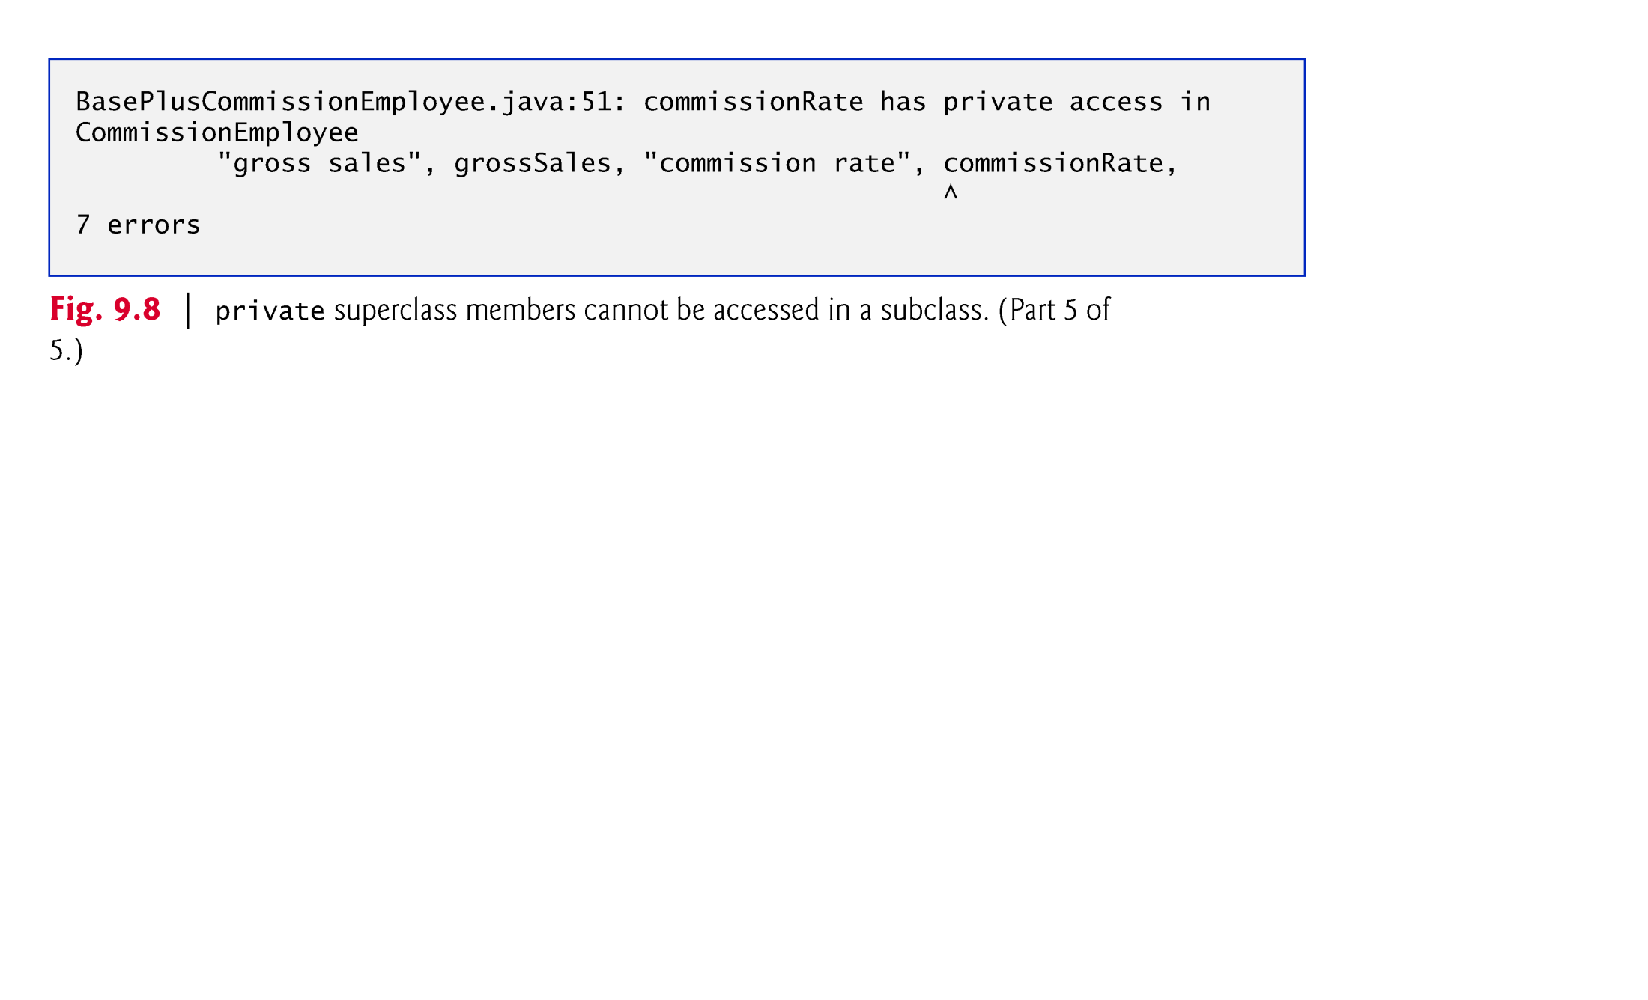

Slide 59
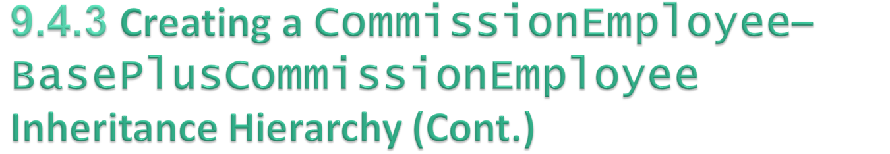
Each subclass constructor must implicitly or explicitly call its superclass constructor to initialize the instance variables inherited from the superclass.
  Superclass constructor call syntax—keyword super, followed by a set of parentheses containing the superclass constructor arguments.
  Must be the first statement in the subclass constructor’s body.
If the subclass constructor did not invoke the superclass’s constructor explicitly, Java would attempt to invoke the superclass’s no-argument or default constructor.
  Class CommissionEmployee does not have such a constructor, so the compiler would issue an error.
You can explicitly use super() to call the superclass’s no-argument or default constructor, but this is rarely done.
© Copyright 1992-2012 by Pearson Education, Inc. All Rights Reserved.

Slide 60
Compilation errors occur when the subclass attempts to access the superclass’s private instance variables.
These lines could have used appropriate get methods to retrieve the values of the superclass’s instance variables.
© Copyright 1992-2012 by Pearson Education, Inc. All Rights Reserved.

Slide 61
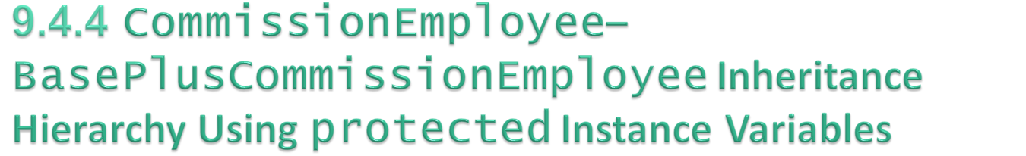
To enable a subclass to directly access superclass instance variables, we can declare those members as protected in the superclass.
New CommissionEmployee class modified only lines 6–10 of Fig. 9.4 as follows:
    protected String firstName;
    protected String lastName;
    protected String socialSecurityNumber;
    protected double grossSales;
    protected double commissionRate;
With protected instance variables, the subclass gets access to the instance variables, but classes that are not subclasses and classes that are not in the same package cannot access these variables directly.
© Copyright 1992-2012 by Pearson Education, Inc. All Rights Reserved.

Slide 62

Class BasePlusCommissionEmployee (Fig. 9.9) extends the new version of class CommissionEmployee with protected instance variables.
  These variables are now protected members of BasePlusCommissionEmployee.
If another class extends this version of class BasePlusCommissionEmployee, the new subclass also can access the protected members.
The source code in Fig. 9.9 (51 lines) is considerably shorter than that in Fig. 9.6 (128 lines)
  Most of the functionality is now inherited from CommissionEmployee
  There is now only one copy of the functionality.
  Code is easier to maintain, modify and debug—the code related to a commission employee exists only in class CommissionEmployee.
© Copyright 1992-2012 by Pearson Education, Inc. All Rights Reserved.

Slide 63
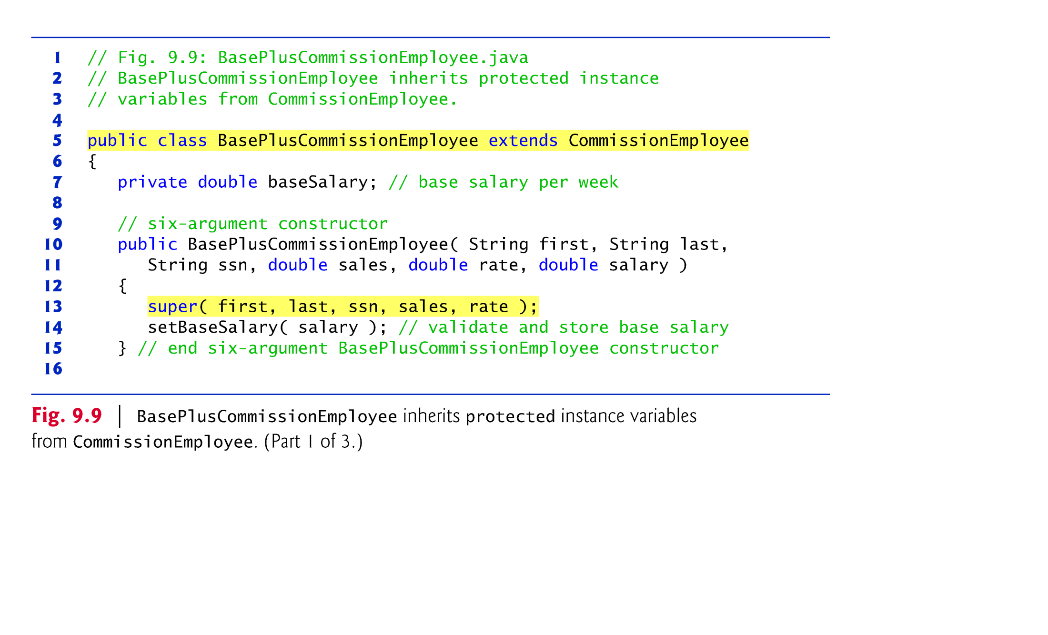

Slide 64
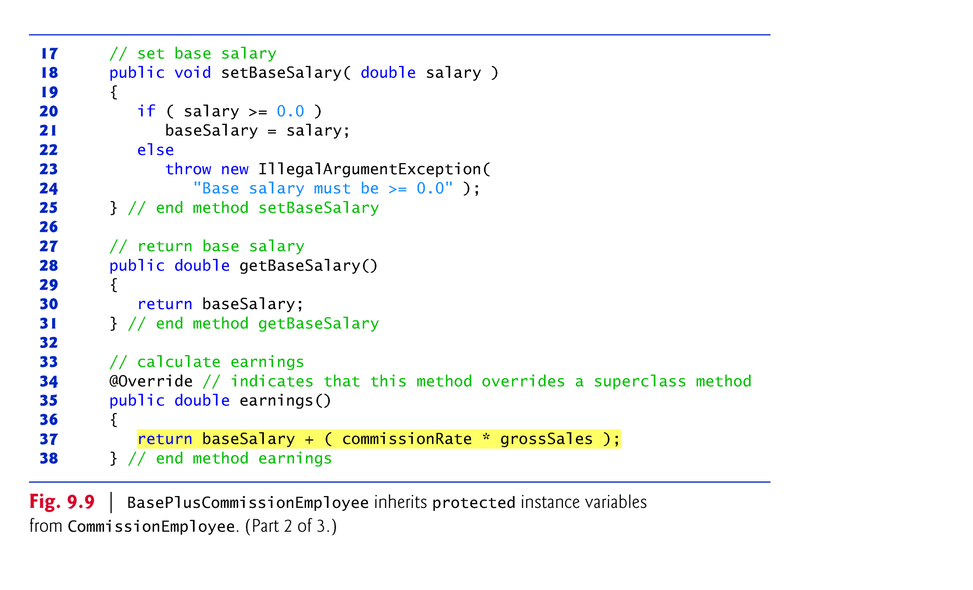

Slide 66
Inheriting protected instance variables slightly increases performance, because we can directly access the variables in the subclass without incurring the overhead of a set or get method call.
In most cases, it’s better to use private instance variables to encourage proper software engineering, and leave code optimization issues to the compiler.
  Code will be easier to maintain, modify and debug.
© Copyright 1992-2012 by Pearson Education, Inc. All Rights Reserved.

Slide 67
Using protected instance variables creates several potential problems.
The subclass object can set an inherited variable’s value directly without using a set method.
  A subclass object can assign an invalid value to the variable
A class’s protected members are visible to all classes in the same package as the class containing the protected members—this is not always desirable.
© Copyright 1992-2012 by Pearson Education, Inc. All Rights Reserved.

Slide 68

Hierarchy reengineered using good software engineering practices.
Class CommissionEmployee declares instance variables firstName, lastName, socialSecurityNumber, grossSales and commissionRate as private and provides public methods for manipulating these values.
© Copyright 1992-2012 by Pearson Education, Inc. All Rights Reserved.

Slide 69

CommissionEmployee methods earnings and toString use the class’s get methods to obtain the values of its instance variables.
  If we decide to change the internal representation of the data (e.g., variable names) only the bodies of the get and set methods that directly manipulate the instance variables will need to change.
  These changes occur solely within the superclass-—no changes to the subclass are needed.
  Localizing the effects of changes like this is a good software engineering practice.
Subclass BasePlusCommissionEmployee inherits Commission-Employee’s non-private methods and can access the private superclass members via those methods.
© Copyright 1992-2012 by Pearson Education, Inc. All Rights Reserved.

Slide 70
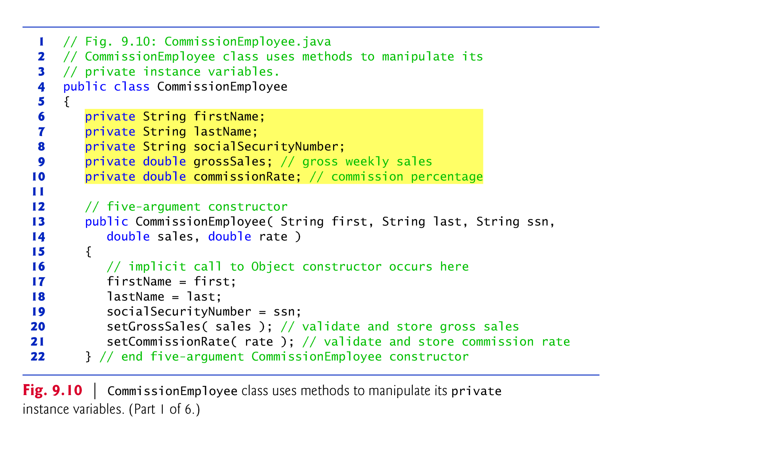

Slide 71
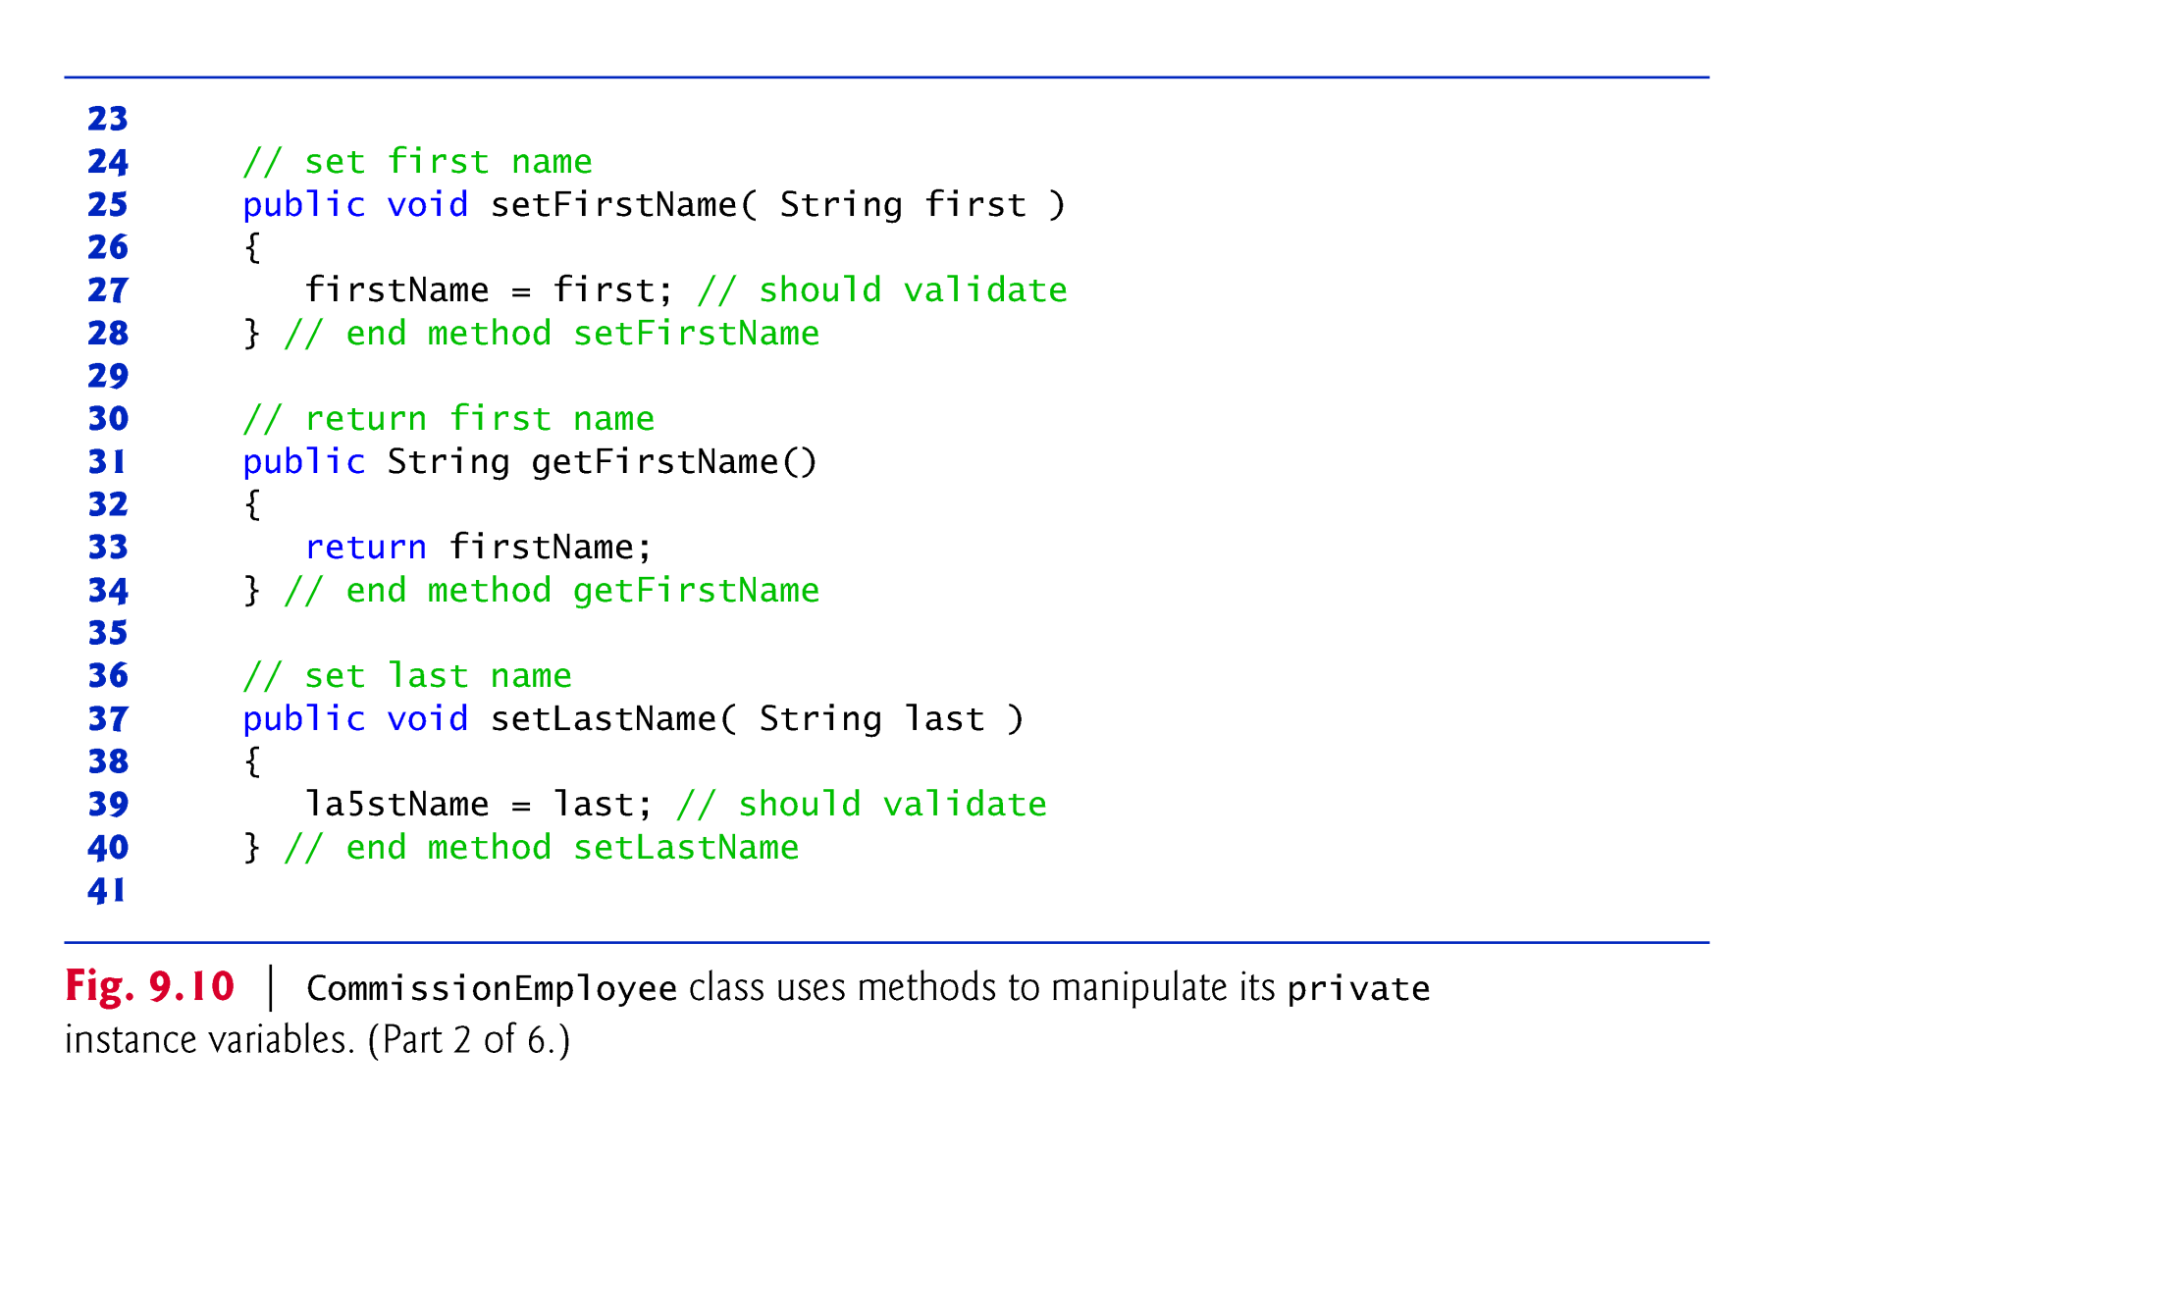

Slide 72
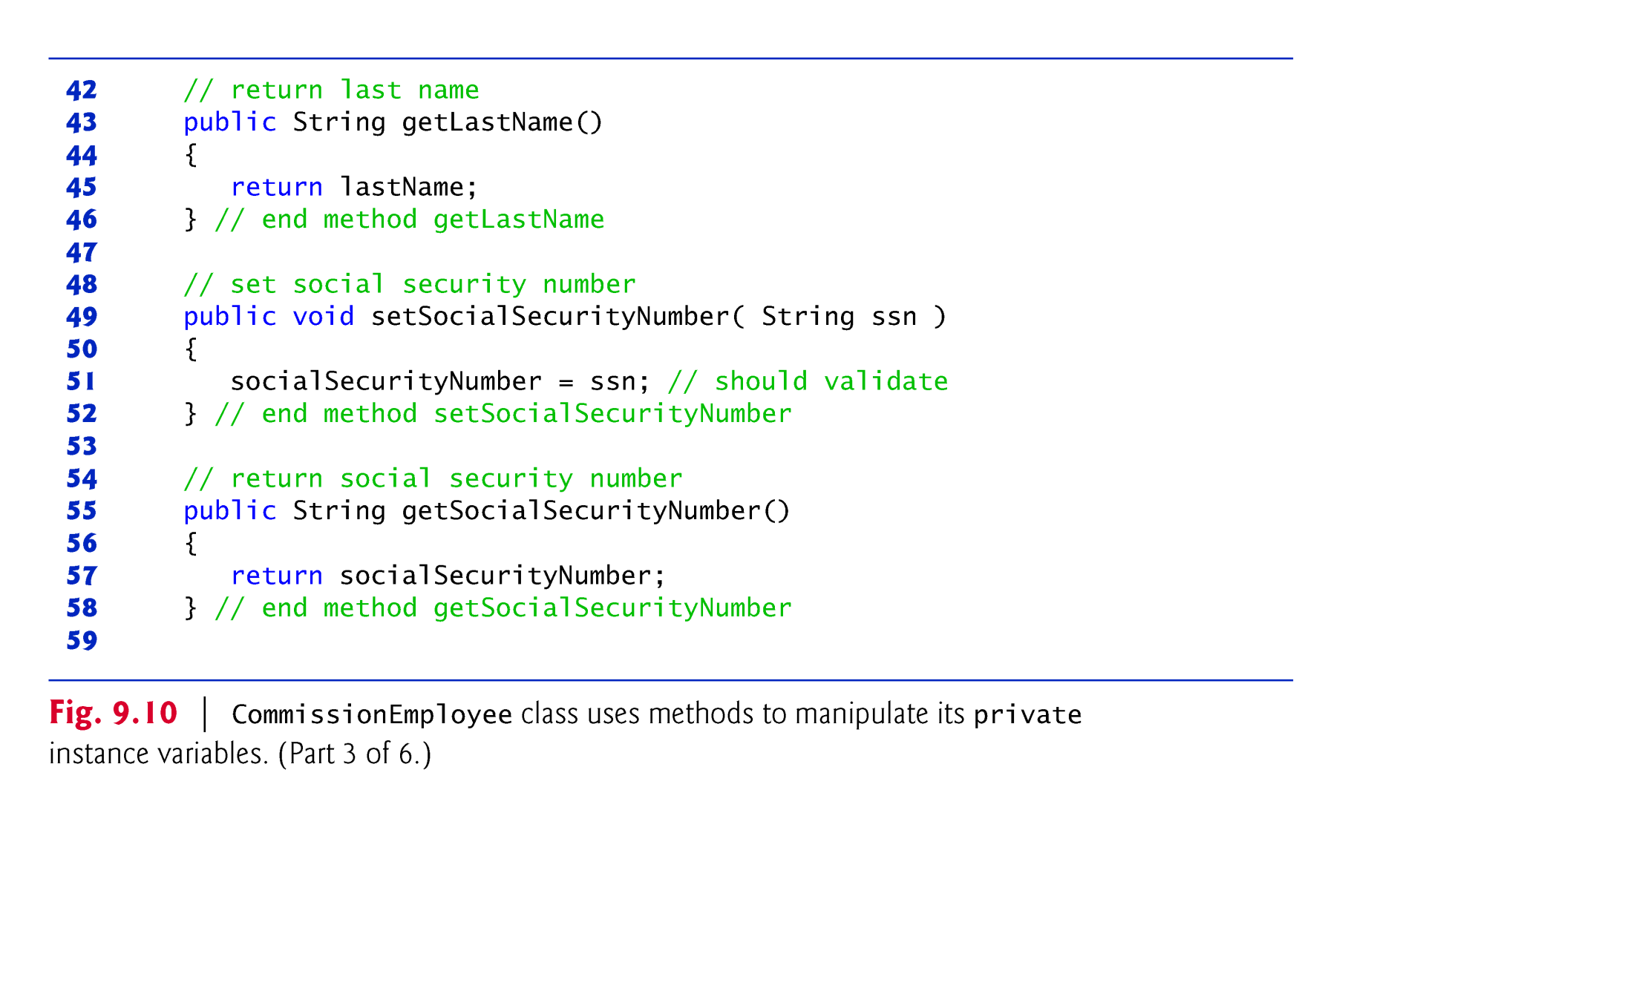

Slide 73
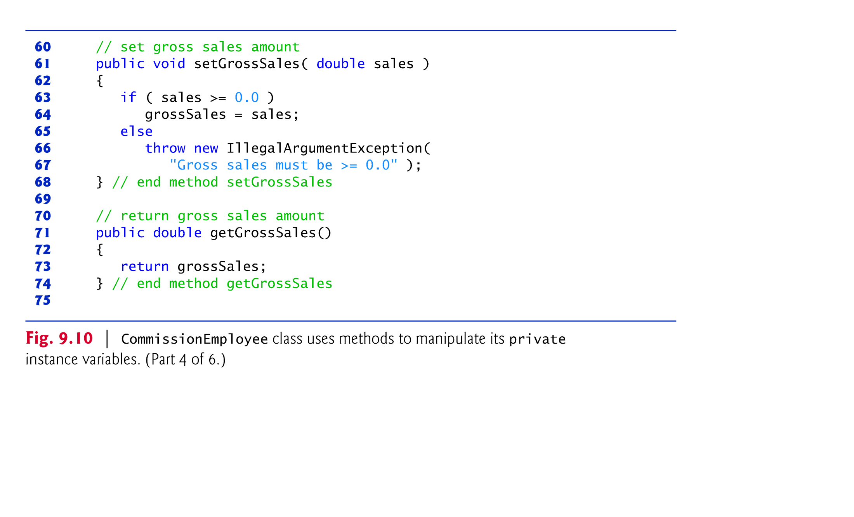

Slide 74
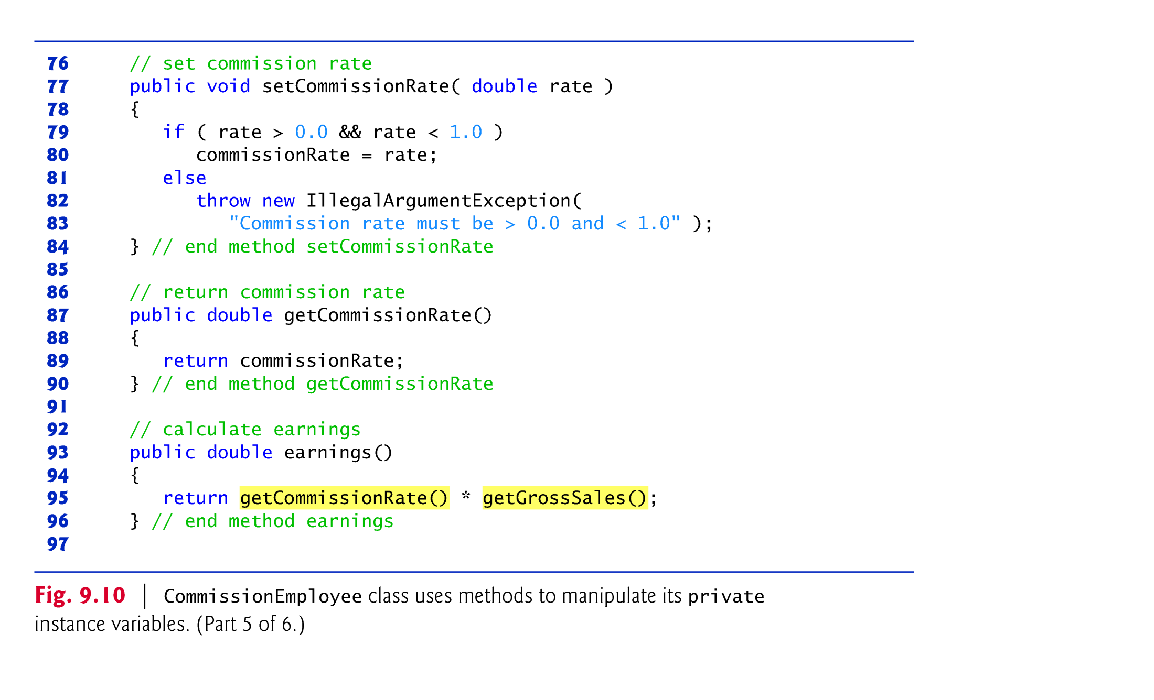

Slide 75
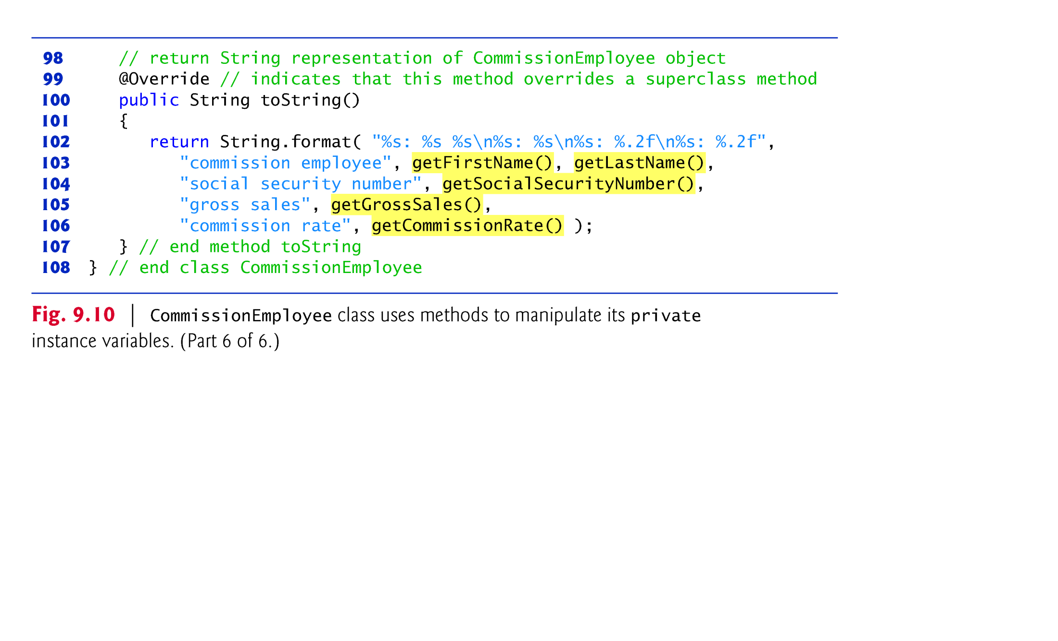

Slide 76
Class BasePlusCommissionEmployee (Fig. 9.11) has several changes that distinguish it from Fig. 9.9.
Methods earnings and toString each invoke their superclass versions and do not access instance variables directly.
© Copyright 1992-2012 by Pearson Education, Inc. All Rights Reserved.

Slide 77
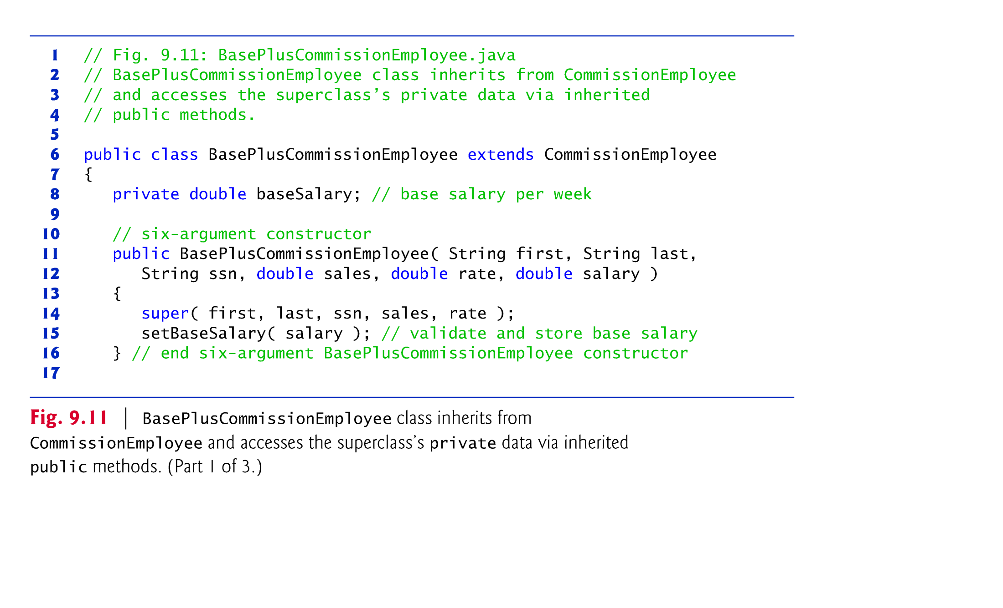

Slide 78
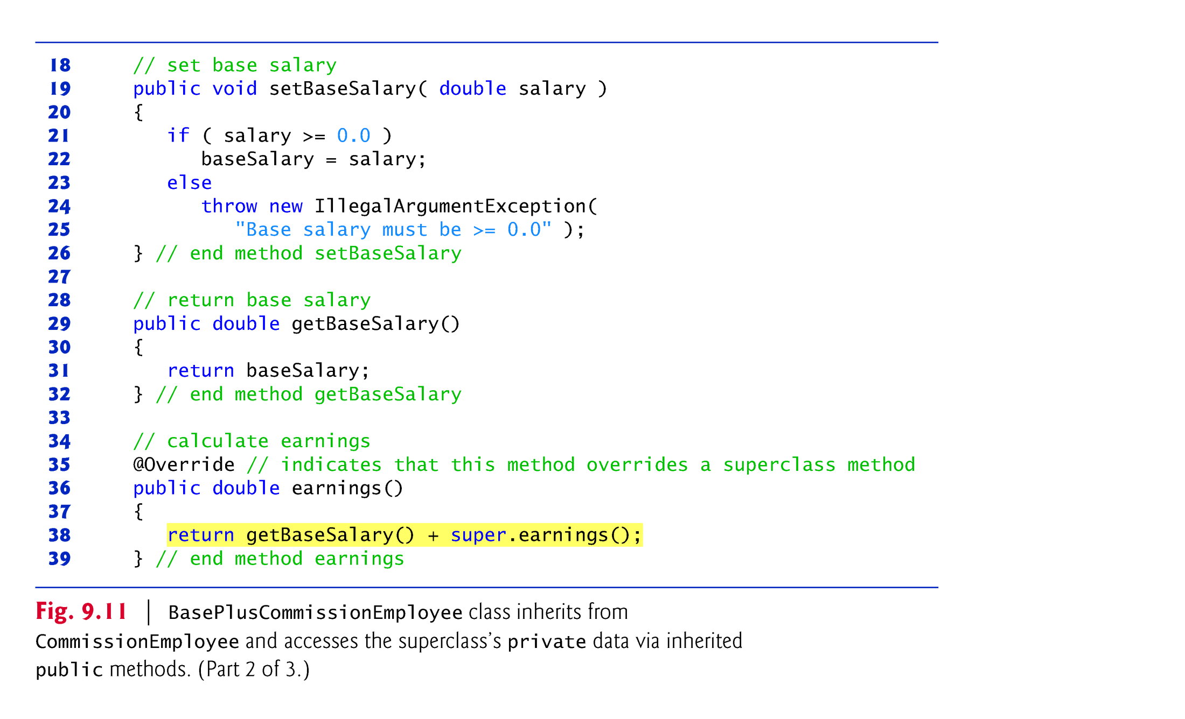

Slide 79
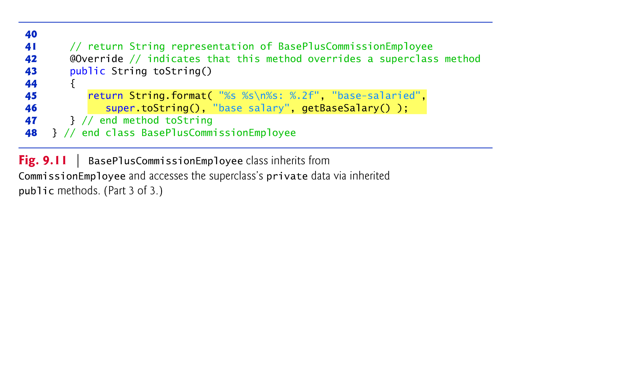

Slide 80
Method earnings overrides class the superclass’s earnings method.
The new version calls CommissionEmployee’s earnings method with super.earnings().
  Obtains the earnings based on commission alone
Placing the keyword super and a dot (.) separator before the superclass method name invokes the superclass version of an overridden method.
Good software engineering practice
  If a method performs all or some of the actions needed by another method, call that method rather than duplicate its code.
© Copyright 1992-2012 by Pearson Education, Inc. All Rights Reserved.

Slide 81
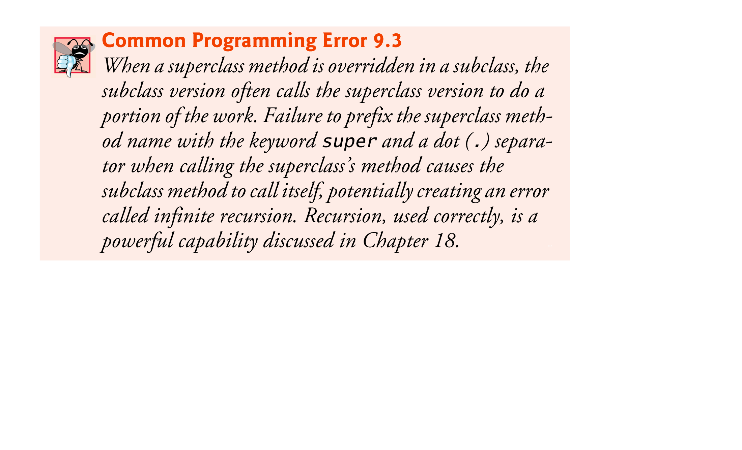

Slide 82
BasePlusCommissionEmployee’s toString method overrides class CommissionEmployee’s toString method.
The new version creates part of the String representation by calling CommissionEmployee’s toString method with the expression super.toString().
© Copyright 1992-2012 by Pearson Education, Inc. All Rights Reserved.

Slide 83

Instantiating a subclass object begins a chain of constructor calls
  The subclass constructor, before performing its own tasks, invokes its direct superclass’s constructor
If the superclass is derived from another class, the superclass constructor invokes the constructor of the next class up the hierarchy, and so on.
The last constructor called in the chain is always class Object’s constructor.
Original subclass constructor’s body finishes executing last.
Each superclass’s constructor manipulates the superclass instance variables that the subclass object inherits.
© Copyright 1992-2012 by Pearson Education, Inc. All Rights Reserved.

Slide 84

When you extend a class, the new class inherits the superclass’s members—though the private superclass members are hidden in the new class.
You can customize the new class to meet your needs by including additional members and by overriding superclass members.
  Doing this does not require the subclass programmer to change (or even have access to) the superclass’s source code.
  Java simply requires access to the superclass’s .class file.
© Copyright 1992-2012 by Pearson Education, Inc. All Rights Reserved.

Slide 85
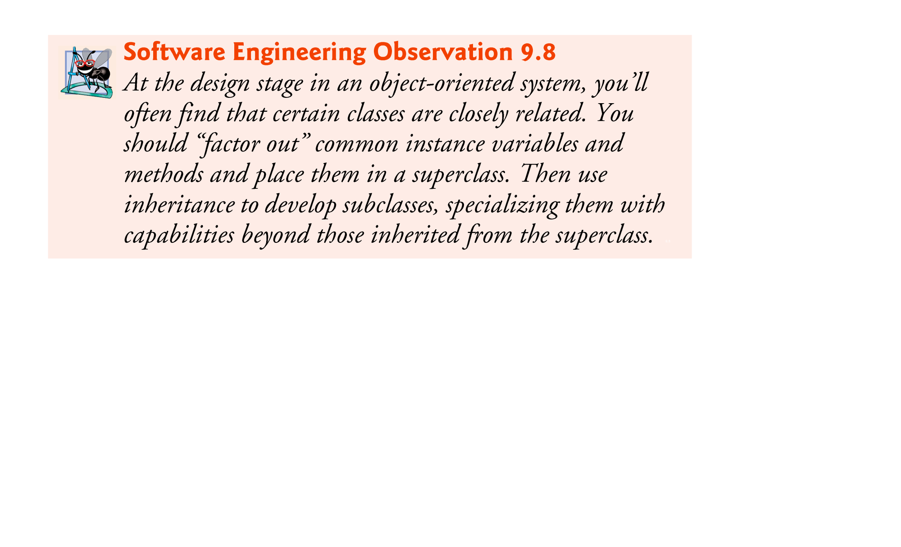
© Copyright 1992-2012 by Pearson Education, Inc. All Rights Reserved.

Slide 86

Multiple inheritance: the ability to extend more than one classes
Multiple inheritance ...
  Is difficult to implement efficiently
  Can lead to ambiguity: if two parents implement the same method, which to use?
  Therefore, Java does not allow a class to extend more than one class
  However, interfaces (will be discussed in future) can solve the problem of multiple inheritance
Chapter 3: Inheritance and Class Hierarchies

Slide 87

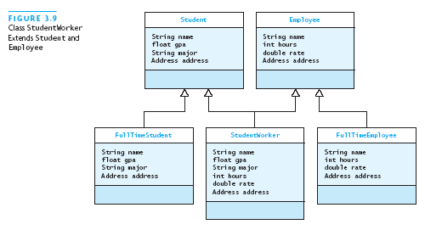
In the following diagram, there is ambiguity in StudentWorker class
The inheritance relationship is shown as a hollow arrow
Which of the ‘name’ field value should be inherited in StudentWorker… Student’s or Employee’s
Desired,
but illegal,
situation

Slide 88

All classes in Java inherit directly or indirectly from Object, so its 11 methods are inherited by all other classes.
Figure 9.12 summarizes Object’s methods.
Every array has an overridden clone method that copies the array.
  If the array stores references to objects, the objects are not copied—a shallow copy is performed.
© Copyright 1992-2012 by Pearson Education, Inc. All Rights Reserved.

Slide 89
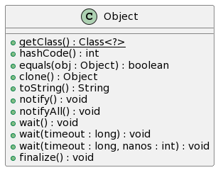
© Copyright 1992-2012 by Pearson Education, Inc. All Rights Reserved.

Slide 91
